Slide 1
How to build/run user applications
山下智弘
JST CREST/神戸大学
Borrowing especially from presentations of M. Asai(SLAC)
Geant4 Tutorial @ Japan 2007
17-19 Oct, 2007 @ RCNS, based on Geant4 9.0.p01

Slide 2
Outline
Mandatory user classes
User actions
How to write main()
How to configure/build user applications
How to run user applications
UI commands and macro
How to visualize

Slide 3
I. Mandatory user classes
Geant4 is a toolkit. You have to build an application.
To make an application, you have to
  Define your geometrical setup
    G4VUserDetectorConstruction - Material, volume
  Define physics to get involved
    G4VUserPhysicsList - Particles, physics processes/models
    Production thresholds
  Define how an event starts
    G4VUserPrimaryGeneratorAction - Primary track generation
My Application
MyDetectorConstruction
Material, volume
MyPhysicsList
Particles, processes, cuts
MyPrimaryGeneratorAction
Primary track generation
G4VUser
DetectorConstruction
G4VUserPhysicsList
G4VUser
PrimaryGeneratorAction

Slide 4
I. Mandatory user classes
1. DetectorConstruction
Derive your own concrete class from G4VUserDettectorConstruction abstract base class.
  e.g. class MyDetectorConstruction : public G4VUserDetectorConstruction
In the virtual method Construct() of your UserDetectorConstruction
  Define all necessary materials
  Define volumes of your detector geometry
Optionally you can define
  your sensitive detector classes and set them to the corresponding logical volumes
  Regions for any part of your detector
  Visualization attributes (color, visibility, etc.) of your detector elements

Slide 5
I. Mandatory user classes
2. PhysicsList
Geant4 does not have any default particles or processes.
  Even for the particle transportation, you have to define it explicitly.
Derive your own concrete class from G4VUserPhysicsList abstract base class.
  Define all necessary particles
  Define all necessary processes and assign them to proper particles
  Define cut-off ranges applied to the world (and each region)
Geant4 provides lots of utility classes/methods and examples.
  "Educated guess" physics lists for defining hadronic processes for various use-cases.

Slide 6
I. Mandatory user classes
3. PrimaryGeneratorAction
Derive your concrete class from G4VUserPrimaryGeneratorAction abstract base class.
Pass a G4Event object to one or more primary generator concrete class objects which generate primary vertices and primary particles.
Geant4 provides several generators in addition to the G4VPrimaryGenerator base class.
  G4ParticleGun
  G4HEPEvtInterface, G4HepMCInterface
    Interface to /hepevt/ common block or HepMC class
  G4GeneralParticleSource
    Define radioactivity

Slide 7
II. User actions(1)
5 user action classes
methods of which are invoked during “Beam On”
  G4UserRunAction
  G4UserEventtAction
  G4UserStackingAction
  G4UserTrackingAction
  G4UserSteppingAction

Slide 8
II. User actions(2)
G4UserRunAction
  G4Run* GenerateRun()
    Instantiate user-customized run object
  void BeginOfRunAction(const G4Run*)
    Define histograms, TTree
  void EndOfRunAction(const G4Run*)
    Store histograms, TTree
G4UserEventAction
  void BeginOfEventAction(const G4Event*)
    Event selection
  void EndOfEventAction(const G4Event*)
    Analyze the event

Slide 9
II. User actions(3)
G4UserStackingAction
  void PrepareNewEvent()
    Reset priority control
  G4ClassificationOfNewTrack ClassifyNewTrack(const G4Track*)
    Invoked every time a new track is pushed
    Classify a new track - priority control
    Urgent, Waiting, PostponeToNextEvent, Kill
  void NewStage()
    Invoked when the Urgent stack becomes empty
    Change the classification criteria
    Event filtering (Event abortion)

Slide 10
II. User actions(4)
G4UserTrackingAction
  void PreUserTrackingAction(const G4Track*)
    Decide trajectory should be stored or not
    Create user-defined trajectory
  void PostUserTrackingAction(const G4Track*)
G4UserSteppingAction
  void UserSteppingAction(const G4Step*)
    Kill / suspend / postpone the track
    Draw the step (for a track not to be stored as a trajectory)

Slide 11
III. How to write main
Geant4 does not provide the main()
In your main(), you have to
  Construct G4RunManager (or your derived class)
  Set user mandatory classes to RunManager
    Use G4RunManager::SetUserInitialization() to set
      G4VUserDetectorConstruction
      G4VUserPhysicsList
    Use G4RunManager:::SetUserAction() to set
      G4VUserPrimaryGeneratorAction
      And optional user action classes
You can define VisManager, (G)UI session in your main().
G4RunManager
MyDetector
Construction
G4VUser
DetectorConstruction
MyPhysicsList
G4VUserPhysicsList
MyPrimary
GeneratorAction
G4VUser
PrimaryGeneratorAction

Slide 12
III. How to write main(2) example
Construct G4RunManager
int main(int argc, char** argv)
{
G4RunManager* runManager = new G4RunManager;
G4VUserDetectorConstruction* detector =
new MyDetectorConstruction();
runManager->SetUserInitialization(detector);
//
G4VUserPhysicsList* physics =
new HadrontherapyPhysicsList;
runManager->SetUserInitialization(physics);
G4VUserPrimaryGeneratorAction* gen_action =
new MyPrimaryGeneratorAction();
runManager->SetUserAction(gen_action);
…
Construct mandatory initialization classes
Set mandatory initialization classes to G4RunManager
Construct mandatory action class and set
to G4RunManager

Slide 13
III. How to write main(2) example cotnd.
Construct non-mandatory action class and set
to G4RunManager
…
G4UserRunAction* run_action = new MyRunAction;
runManager->SetUserAction(run_action);
runManager->Initialize();
if (argc != 1) { // batch mode
G4UImanager * UI = G4UImanager::GetUIpointer();
G4String command = "/control/execute ";
G4String fileName = argv[1];
UI->ApplyCommand(command+fileName);
} else { // interactive mode : define UI terminal
G4UIsession * session = new G4UIterminal(new G4UItcsh);
session->SessionStart();
delete session;
}
delete runManager;
return 0;
}
Initialize G4 kernel
Start a run
Delete G4 kernel

Slide 14
IV. How to configure/build user applications
1. Environment variables
Mandatory variables
  G4SYSTEM – OS (e.g. Linux-g++)
  G4INSTALL – base directory of Geant4
  CLHEP_BASE_DIR – base directory of CLHEP
Variables for physics processes in case corresponding processes are used
  G4LEVELGAMMADATA - photon evaporation
  G4LEDATA - cross-sections for Low-E EM module
  G4RADIOACTIVEDATA - radioactive decay
  G4NEUTRONHPDATA - neutron cross-section
Additional variables for GUI/Vis/Analysis

Slide 15
IV. How to configure/build user applications
2. Source files
Prepare directory for your application. In that directory
  myApplication.cc
    File in which main() is defined
  src/
    Source files of mandatory user classes and optional user run action classes
  includes/
    Header files
  GNUmakefile
ApplicationDirectory/
src/
include/
GNUmakefile
myApplication.cc
src/
MyDetectorConstruction.cc
MyPhyiscsList.cc
*.cc
include/
MyDetectorConstruction.hh
MyPhyiscsList.hh
*.hh

Slide 16
IV. How to configure/build user applications
3. GNUmakefile
  name := myApplication
  G4TARGET := $(name)
  G4EXLIB := true
  G4WORKDIR := .
  .PHONY: all
  all: lib bin
  include $(G4INSTALL)/config/binmake.gmk
Command gmake will create
  executable in bin/$G4SYSTEM/
  temporary object files in tmp/$G4SYSTEM/myApplication/

Slide 17
V. How to run user applications
1. Ways to run Geant4 application
There are 3 Ways to run Geant4 application
  Hard-coded batch mode
  interactive mode, driven by command lines
    Use G4UIsession
  batch mode, but reading a macro of commands
    Use G4UIsession
  interactive mode via a Graphical User Interface

Slide 18
V. How to run user applications
2. Using G4UIsession
In your main main(), according to your computer environments, construct a G4UIsession concrete class provided by Geant4 and invoke its sessionStart() method.
Geant4 provides
  G4UIterminal and G4UItcsh
    character terminal
  G4UIXm, G4UIXaw and G4UIWin32
    variations of the upper terminal by using a Motif, Athena or Windows widget
  G4UIGAG and G4UIGainServer
    a fully Graphical User Interface and its extension GainServer of the client/server type

Slide 19
V. How to run user applications
3. How to write main() for using UIsession
...
int main(int argc, char** argv) {
...
if (argc != 1) { // batch mode
G4UImanager * UI = G4UImanager::GetUIpointer();
G4String command = "/control/execute ";
G4String fileName = argv[1];
UI->ApplyCommand(command+fileName);
}
else { // interactive mode : define UI terminal
G4UIsession * session =
new G4UIterminal(new G4UItcsh);
session->SessionStart();
delete session;
}
...

Slide 20
VI. UI commands and macro
A command consists of
  Command directory
  Command
  Parameter(s)
A parameter can be a type of string, boolean, integer or double.
  Space is a delimiter.
  Use double-quotes (“”) for string with space(s).
A parameter may be “omittable”. If it is the case, a default value will be taken if you omit the parameter.
  Default value is either predefined default value or current value according to its definition
  If you want to use the default value for your first parameter while you want to set your second parameter, use “!” as a place holder.
  dir/command ! Second
  /run/beamOn 1

Slide 21
VI. UI commands and macro
1. Command submission
Geant4 UI command can be issued by
  Hard-coded implementation
  (G)UI interactive command submission
  Macro file
The availability of individual command, the ranges of parameters vary
  implementation of your application
  May vary dynamically during the execution
some commands are available only for limited Geant4 application state(s).
E.g. /run/beamOn is available only for Idle states.

Slide 22
VI. UI commands and macro
2. Marco file
Macro file is an ASCII file contains UI commands.
All commands must be given with their full-path directories.
Use “#” for comment line.
  First “#” to the end of the line will be ignored.
  Comment lines will be echoed if /control/verbose is set to 2.
Macro file can be executed
  interactively or in (other) macro file
  /control/execute file_name
  hard-coded
  G4UImanager* UI = G4UImanager::GetUIpointer();
  UI->ApplyCommand("/control/execute file_name");

Slide 23
VI. UI commands and macro
3. Command refusal
Command will be refused if
  Wrong application state
  Wrong type of parameter
  Insufficient number of parameters
  Parameter out of its range
  For integer or double type parameter
  Parameter out of its candidate list
  For string type parameter
  Command not found

Slide 24
VI. UI commands and macro
4. G4UIterminal
G4UIterminal is a concrete implementation derived from G4UIsession abstract class. It provides character-base interactive terminal functionality to issue Geant4 UI commands
  C-shell or TC-shell (Linux only)
It supports some Unix-like commands for directory manipulation
  cd, pwd - change and display current command directory
    By setting the current command directory, you may omit (part of) directory string
  ls - list available UI commands and sub--directories
It also supports some other commands
  history - show previous commands
  ! historyID -re-issue previous command
  arrow keys (TCarrow TC--shell only)
  ? UIcommand - show current value
  help [UIcommand] – help
  exit – job termination
Above commands are interpreted in G4UIterminal and are not passed to Geant4 kernel. Cannot use them in a macro file.

Slide 25
VI. UI commands and macro
4. G4UIterminal example
Idle> ls
Command directory path : /
Sub-directories :
/control/ UI control commands.
/units/ Available units.
/persistency/ Control commands for Persistency package
/geometry/ Geometry control commands.
/tracking/ TrackingManager and SteppingManager control commands.
/event/ EventManager control commands.
/run/ Run control commands.
/random/ Random number status control commands.
/particle/ Particle control commands.
/process/ Process Table control commands.
/physics/ ...Title not available...
/gun/ Particle Gun control commands.
/vis/ Visualization commands.
/material/ Commands for materials
/hits/ Sensitive detectors and Hits
Commands :
Idle>

Slide 26
VI. UI commands and macro
4. G4UIterminal example contd.
Idle> cd control/
Idle>ls
Command directory path : /control/
Guidance :
UI control commands.
Sub-directories :
/control/matScan/ Material scanner commands.
Commands :
execute * Execute a macro file.
loop * Execute a macro file more than once.
foreach * Execute a macro file more than once.
suppressAbortion * Suppress the program abortion caused by G4Exception.
verbose * Applied command will also be shown on screen.
…
createHTML * Generate HTML files for all of sub-directories and commands.
maximumStoredHistory * Set maximum number of stored UI commands.
Idle>

Slide 27
VI. UI commands and macro
4. G4UIterminal example contd.
Idle> help /gun/energy
Command /gun/energy
Guidance :
Set kinetic energy.
Parameter : Energy
Parameter type : d
Omittable : True
Default value : taken from the current value
Parameter : Unit
Parameter type : s
Omittable : True
Default value : GeV
Candidates : eV keV MeV GeV TeV PeV J electronvolt kiloelectronvolt megaelectronvolt gigaelectronvolt teraelectronvolt petaelectronvolt joule
Idle>

Slide 28
VII. How to visualize
1. What can be visualized
Simulation data can be visualized:
  Detector components
  Particle trajectories and tracking steps
  Hits of particles in detector components
Other user defined objects can be visualized:
  Polylines
    such as coordinate axes
  3D Markers
    such as eye guides
  Text
    descriptive character strings
    comments or titles …

Slide 29
VII. How to visualize
2. Seven Visualization Drivers
OpenGL
OpenInventor
HepRep/WIRED (and FRED)
DAWN
VRML
RayTracer
ASCIITree

Slide 30
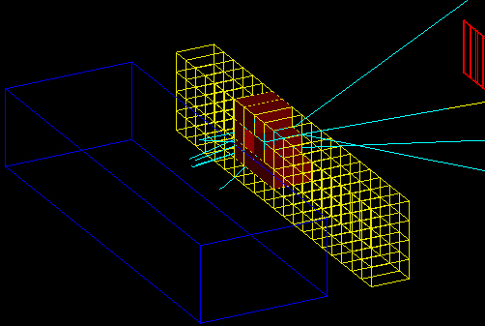
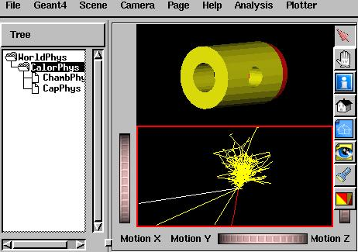
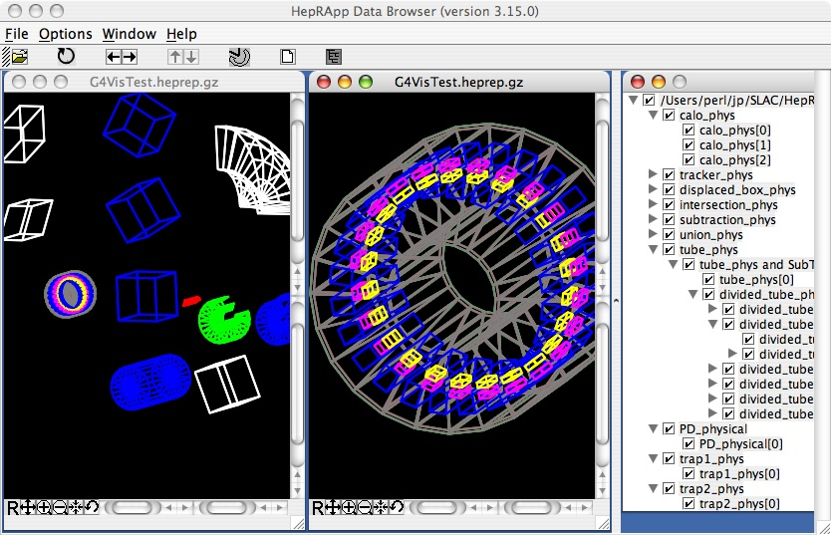
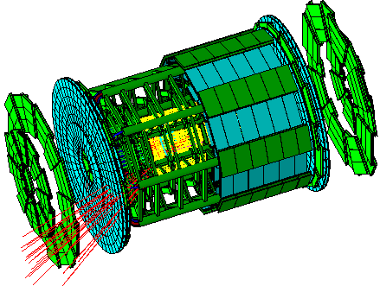
OpenGL
OpenInventor
HepRep/HepRApp
DAWN

Slide 31
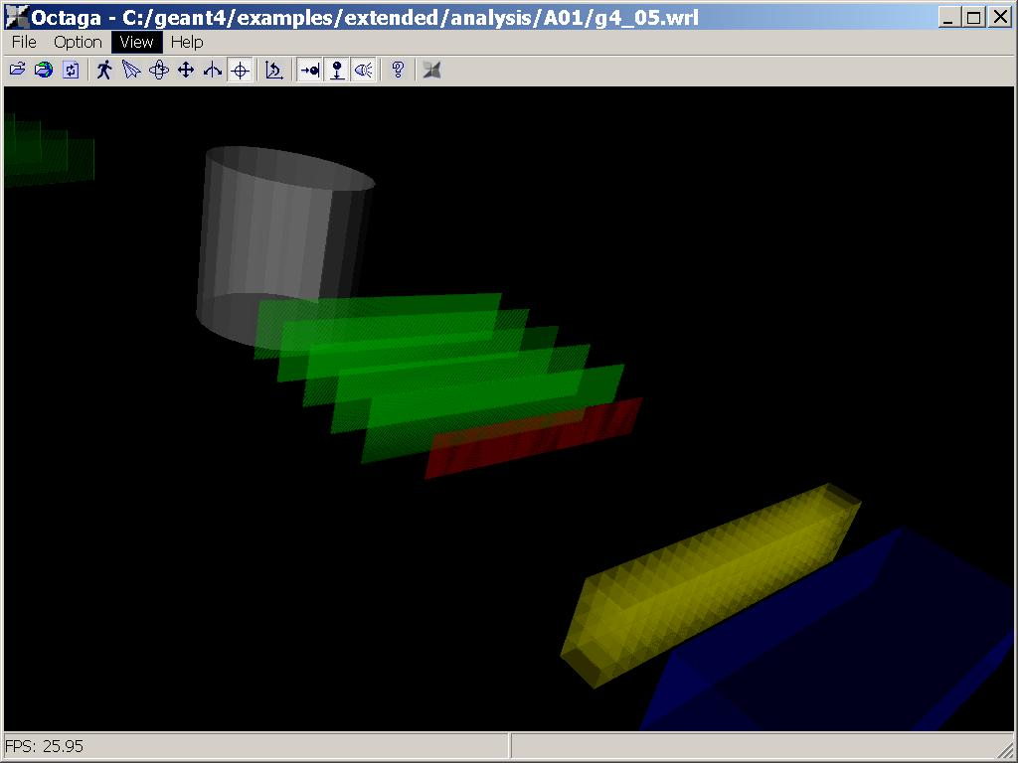
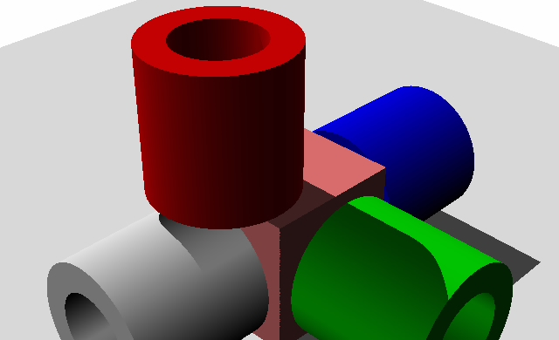
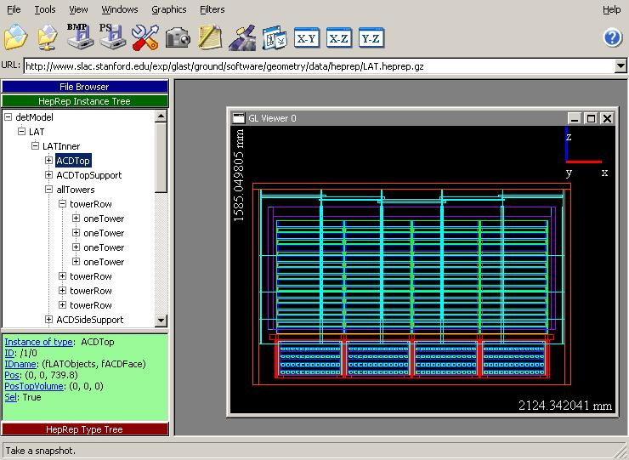
VRML
RayTracer
HepRep/FRED

Slide 32
VII. How to visualize
3. Choose the Driver that Meets your Current Needs
If you want responsive
  OpenGL
If you want interactivity
  OpenInventor, HepRep/WIRED
If you want highest quality
  DAWN
If you want to render to a 3D format that others can view in a variety of commodity browsers
  VRML
If you want photo-realistic high quality
  RayTrace
If you want to quickly check the geometry hierarchy
  ASCIITree

Slide 33
VII. How to visualize
4. Adding Visualization to Your Executable
Visualization Drivers must be installed
Environmental variables may be needed
  G4VIS_BUILD_DRIVERNAME_DRIVER and G4VIS_USE_DRIVERNAME
How to write the main()
  …
  #ifdef G4VIS_USE
  #include "G4VisExecutive.hh"
  #endif
  …
  #ifdef G4VIS_USE
  G4VisManager* visManager = new G4VisExecutive;
  visManager->Initialize();
  #endif
  …
  #ifdef G4VIS_USE
  delete visManager;
  #endif
  …

Slide 34
VII. How to visualize
5. Visualization commands
Visualize a detector using DAWN
  /vis/open DAWNFILE
  /vis/drawVolume
  /vis/viewer/flush
Visualize trajectories for 10 events using OpenGL
  /vis/open OGLIX
  /vis/viewer/set/viewpointThetaPhi 70 20
  /vis/viewer/zoom 2
  /vis/drawVolume
  /vis/scene/add/trajectories
  /vis/scene/endOfEventAction accumulate
  /run/beamOn 10
Create DAWN file
Draw detector
Execute the visualization
Camera control
Draw trajectories of particles
Accumulate trajectories in a figure

Slide 35
VII. How to visualize
6. Controlling visualization attributes
In Construct() of DetectorConstruction
…
  logicCalor = new G4LogicalVolume(…);
  …
  G4VisAttributes* simpleBoxVisAtt =
  new G4VisAttributes(G4Colour(1.0, 0, 0));
  logicCalor->SetVisAttributes(simpleBoxVisAtt);
  logicWorld
  ->SetVisAttributes(G4VisAttributes::Invisible);
  …

