Slide 1
Sensitive Detector and Hits
山下智弘
JST CREST/神戸大学
Borrowing especially from presentations of M. Asai(SLAC)
Geant4 Tutorial @ Japan 2007
17-19 Oct, 2007 @ RCNS, based on Geant4 9.0.p01

Slide 2
Outline
Introduction
Sensitive detector
Hits and hit collection
How to describe detector sensitivity
Touchable

Slide 3
I. Introduction
Given geometry, physics and primary track generation, Geantt4 does proper physics simulation “silently”.
  Need a bit of code to extract useful information
There are two ways:
  Use user hooks (G4UserTrackingAction, G4UserSteppingAction, etc.)
    You have full access to almost all information
    Straight-forward, but DIY(do-it-yourself)
  Use Geant4 scoring functionality
    Assign G4VSensitiveDetector to interested logical volume

Slide 4
II Sensitive detector
Introduction
In ProcessHits method, sensitive detector creates hits from step and store them into HitsCollection
HitsCollection will be stored in G4HCofThisEvent of G4Event
Step
Hit
Hit
Hit
Hit
Hit
HitsCollectionOfThitsEvent
G4HCofThisEvent
G4Event
Sensitive Detector
HitsCollection
Not Sensitive Detector
Position
Energy deposit
Etc.
Step
ProcessHits
HitsCollectionOfThisEvent will be accessible at the end of event
G4UserEventAction::EndOfEventAction

Slide 5
Class diagram
Concrete class provided by G4
Abstract base class provided by G4
Template class provided by G4
G4LogicalVolume
G4Event
User’s class
has
1
0..1
G4HCofThisEvent
G4VSensitiveDetector
n
G4VHitsCollection
kind of
G4THitsCollection
G4MultiFunctionalDetector
userSensitiveDetector
n
n
G4VHit
G4VPrimitiveSensitivity
G4THitsMap
n
userHitsCollection
or userHitsMap
G4PSDoseScorer
hits map
G4PSDoseScorer
hits map
G4PSDoseScorer
hits map
n
G4PSDoseScorer
hits map
G4PSDoseScorer
hits map
userHit
1

Slide 6
II. Sensitive detector
1. Sensitive detector and Hit
Each LOGICAL VOLUME can have a pointer to a sensitive detector.
  Then this volume becomes SENSITIVE.
HIT is a snapshot of the physical interaction of a track or an accumulation of interactions of tracks in the sensitive region of your detector.
  Position, energy deposit, etc.
A sensitive detector creates hit(s) using the information given in G4Step object. The user has to provide his/her own implementation of the detector response.
Hit objects, which are still the user’s class objects, are collected in a G4Event object at the end of an event.

Slide 7
II. Sensitive detector
2. What can be Sensitive detector
A tracker detector typically generates a hit for every single step of every single (charged) track.
  A tracker hit typically contains
    Position and time
    Energy deposition of the step
    Track ID
A calorimeter detector typically generates a hit for every cell, and accumulates energy deposition in each cell for all steps of all tracks.
  A calorimeter hit typically contains
    Sum of deposited energy
    Cell IID

Slide 8
II. Sensitive detector
3. Step
Step has two points and also “delta” information of a particle (energy loss on the step, time-of-flight spent by the step, etc.).
Each point knows the volume (and material). In case a step is limited by a volume boundary, the end point physically stands on the boundary, and it logically belongs to the next volume.
Note that you must get the volume information from the “PreStepPoint”.
Boundary
Step
Post-step point
Pre-step point

Slide 9
II. Sensitive detector
4. G4SDManager
All Sensitive Detectors must be REGISTERED with the SDM in order to function properly (tip: do it in the SD’s constructor):
    G4SDManager *sdman=G4SDManager::GetSDMpointer()
    sdman->AddSensitiveDetector (this);
A Sensitive Detector Manager (of type G4SDManager) oversees to all operations by Sensitive Detectors.
The SDM is a singleton (only one object at any moment) and can be accessed by using its static method
  G4SDManager::GetSDMpointer()
The SDM can return a hit collection ID (useful for fishing out your collection from the hits collections of the event
  sdman->GetCollectionID(“My Collection”);

Slide 10
II. Sensitive detector
5. Digitizer module and digit
Digit represents a detector output (e.g. ADC/TDC count, trigger signal, etc.).
Digit is created with one or more hits and/or other digits by a user's concrete implementation derived from G4VDigitizerModule.
In contradiction to the sensitive detector which is accessed at tracking time automatically, the digitize() method of each G4VDigitizerModule must be explicitly invoked by the user s code (e.g. at user’s EventAction ).

Slide 11
II. Sensitive detector
6. Defining a sensitive detector
Basic strategy
  G4LogicalVolume* myLogCalor = ……;
  G4VSensetiveDetector* pSensetivePart =
  new MyDetector(“/mydet”);
  G4SDManager* SDMan = G4SDManager::GetSDMpointer();
  SDMan->AddNewDetector(pSensitivePart);
  myLogCalor->SetSensitiveDetector(pSensetivePart);
Each detector object must have a unique name..
  Some logical volumes can share one detector object.
  More than one detector objects can be made from one detector class with different detector name.
  One logical volume cannot have more than one detector objects. But, one detector object can generate more than one kinds of hits.
    e.g. a double-sided silicon micro-strip detector can generate hits for each side separately.

Slide 12
III. Hits and hit collection
1. Hit class
Hit is a user-defined class derived from G4VHit.
You can store various types information by implementing your own concrete Hit class. For example:
  Position and time of the step
  Momentum and energy of the track
  Geometrical information
  Etc. or any combination of above
Hit objects of a concrete hit class must be stored in a dedicated collection which is instantiated from G4THitsCollection template class.
The collection will be associated to a G4Event object via G4HCofThisEvent.
Hits collections are accessible
  through G4Event at the end of event.
  to be used for analyzing an event
  through G4SDManager during processing an event.
  to be used for event filtering.

Slide 13
III. Hits and hit collection
2. G4HCofThisEvent
A G4Event object has a G4HCofThisEvent object at the end of (successful) event processing. G4HCofThisEvent object stores all hits collections made within the event.
  Pointer(s) to the collections may be NULL if collections are not created in the particular event.
  Hits collections are stored by pointers of G4VHitsCollection base class. Thus, you have to cast them to types of individual concrete classes.
  The index number of a Hits collection is unique and unchanged for a run. The index number can be obtained by
  G4SDManager::GetCollectionID(“detName/colName”);
    The index table is also stored in G4Run.

Slide 14
IV. How to describe detector sensitivity
1. Implementation of Hit(1) MyHit.hh
#include "G4VHit.hh"
#include “G4THitsCollection.hh”
#include "G4Allocator.hh"
class MyHit : public G4VHit {
public:
MyHit(some_arguments);
virtual ~MyHit();
virtual void Draw();
private:
// some data members
public:
// some set/get methods
};
typedef G4THitsCollection<MyHit> MyHitsCollection;

Slide 15
IV. How to describe detector sensitivity
1. Implementation of Hit(2) MyHit.hh
extern G4Allocator<MyHit> MyHitAllocator;
inline void* MyHit::operator new(size_t)
{
void *aHit;
aHit = (void *) MyHitAllocator.MallocSingle();
return aHit;
}
inline void MyHit::operator delete(void *aHit)
{
MyHitAllocator.FreeSingle((ExN04CalorimeterHit*) aHit);
}

Slide 16
IV. How to describe detector sensitivity
1. Implementation of Hit(3) MyHit.hh
  private:
  G4double edep;
  G4ThreeVector pos;
  public:
  inline void SetEdep(G4double de)
  { edep = de; }
  inline G4double GetEdep()
  { return edep; }
  inline void SetPos(G4ThreeVector xyz)
  { pos = xyz; }
  inline G4ThreeVector GetPos()
  { return pos; }

Slide 17
IV. How to describe detector sensitivity
1. Implementation of Hit(4) MyHit.cc
G4Allocator<MyHit> MyHitAllocator;
MyHit::MyHit() {}
MyHit::MyHit() {}
ExN02TrackerHit::ExN02TrackerHit(const ExN02TrackerHit& right)
: G4VHit() {
edep = right.edep;
pos = right.pos;
}
const MyHit& MyHit::operator=(const MyHit& right) {
edep = right.edep;
pos = right.pos;
return *this;
}
G4int MyHit::operator==(const MyHit& right) const {
return (this == &right) ? 1 : 0;
}

Slide 18
IV. How to describe detector sensitivity
2. Implementation of Sensitive Detector(1)
Sensitive detector is a user-defined class derived from G4VSensitiveDetector.
  #include "G4VSensitiveDetector.hh"
  #include "MyHit.hh"
  class G4Step;
  class G4HCofThisEvent;
  class MyDetector : public G4VSensitiveDetector
  {
  public:
  MyDetector(G4String name);
  virtual ~MyDetector();
  virtual void Initialize(G4HCofThisEvent*HCE);
  virtual G4bool ProcessHits(G4Step*aStep,
  G4TouchableHistory*ROhist);
  virtual void EndOfEvent(G4HCofThisEvent*HCE);
  private:
  MyHitsCollection * hitsCollection;
  G4int collectionID;
  };

Slide 19
IV. How to describe detector sensitivity
2. Implementation of Sensitive Detector(2)
  MyDetector::MyDetector(G4String detector_name)
  :G4VSensitiveDetector(detector_name),
  collectionID(-1)
  {
  collectionName.insert(“collection_name");
  }
In the constructor, define the name of the hits collection which is handled by this sensitive detector
In case your sensitive detector generates more than one kinds of hits (e.g. anode and cathode hits separately), define all collection names.

Slide 20
IV. How to describe detector sensitivity
2. Implementation of Sensitive Detector(3)
  void MyDetector::Initialize(G4HCofThisEvent*HCE)
  {
  if(collectionID<0) collectionID = GetCollectionID(0);
  hitsCollection = new MyHitsCollection
  (SensitiveDetectorName,collectionName[0]);
  HCE->AddHitsCollection(collectionID,hitsCollection);
  }
Initialize() method is invoked at the beginning of each event.
Get the unique ID number for this collection.
GetCollectionID() is a heavy operation. It should not be used for every events.
GetCollectionID() is available after this sensitive detector object is constructed and registered to G4SDManager. Thus, this method cannot be invoked in the constructor of this detector class.
Instantiate hits collection(s) and attach it/them to G4HCofThisEvent object given in the argument.

Slide 21
IV. How to describe detector sensitivity
2. Implementation of Sensitive Detector(4)
  G4bool MyDetector::ProcessHits
  (G4Step*aStep,G4TouchableHistory*ROhist)
  {
  MyHit* aHit = new MyHit();
  ...
  // some set methods
  ...
  hitsCollection->insert(aHit);
  return true;
  }
This ProcessHits() method is invoked for every steps in the volume(s) where this sensitive detector is assigned.
In this method, generate a hit corresponding to the current step (for tracking detector), or accumulate the energy deposition of the current step to the existing hit object where the current step belongs to (for calorimeter detector).
Don’t forget to collect geometry information (e.g. copy number) from “PreStepPoint”.

Slide 22
IV. How to describe detector sensitivity
2. Implementation of Sensitive Detector(5)
  void MyDetector::EndOfEvent(G4HCofThisEvent*HCE)
  {;}
This method is invoked at the end of processing an event.
It is invoked even if the event is aborted.
It is invoked before UserEndOfEventAction.

Slide 23
IV. How to describe detector sensitivity
3. Usage of G4HCofThisEvent
void MyEventAction::EndOfEventAction(const G4Event* evt) {
static int CHCID = -1;
If(CHCID<0) CHCID = G4SDManager::GetSDMpointer()
->GetCollectionID("myCal/collection1");
G4HCofThisEvent* HCE = evt->GetHCofThisEvent();
MyHitsCollection* CaloHitsColl = 0;
if(HCE)
{ CaloHitsColl = (MyHitsCollection*)(HCE->GetHC(CHCID)); }
if(CaloHitsColl) {
int n_hit = CaloHitsColl->entries();
G4cout<<“My detector has ”<<n_hit<<" hits."<<G4endl;
for(int i1=0;i1<n_hit;i1++) {
MyHit* aHit = (*CaloHitsColl)[i1];
aHit->Print();
}
}
}

Slide 24
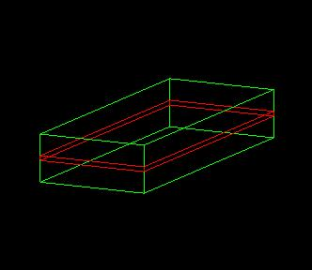
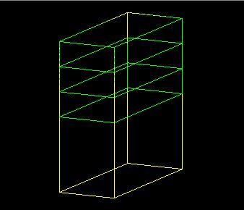
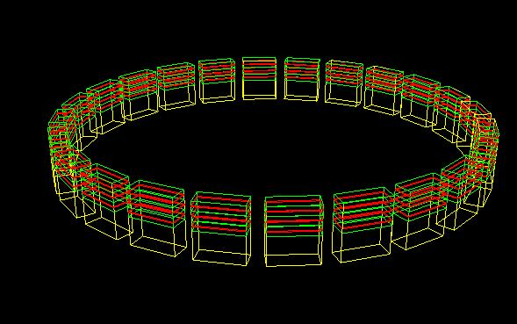
V. Touchable
1. Copy number of replicated volume
Suppose a geometry is made of sensitive layers C which are placed in a volume B
Volume B is a daughter volume of a divided volume A
The volume A has a 24 positions in the world
While in the 'logical' geometry tree the volume C is represented by just one physical volume, in the real world there are many C 'volumes'
How can we then identify these volumes C ?
TOUCHABLE!
B
C
B
A
A

Slide 25
V. Touchable
2. Touchable
A touchable for a volume serves the purpose of providing a unique identification for a detector element
It is a geometrical entity (volume or solid) which has a unique placement in a detector description
  It can be uniquely identified by providing the copy numbers for all daughters in the geometry hierarchy
  In our case these are
    CopyNo of C in B: 1
    CopyNo of B in A: 1,2,3
    CopyNo of A in the world: 1, .., 24
  Example of touchable identification:
    A.3/B.2/C.1
B.1
B.2
B.3
C.1
A.1
A.2
A.3

Slide 26
V. Touchable
2. TouchableHistory
  G4bool ExN04CalorimeterSD::ProcessHits(G4Step*aStep,
  G4TouchableHistory*ROhist){
G4TouchableHistory
  Representing a touchable detector element, and its history in the geomtrical hierarchy, including its net resultant local->global transform.
  depth means always the number of levels up in the tree to be considered:
  depth = 0 : the bottom level (volume C in B)
  depth = 1 : the level of its mother volume (volume B in A)
  depth = 2 : the grandmother volume (volume A in world)
G4int GetCopyNumber(G4int depth =0)
  returns the copy number of the given level of current volume
G4ThreeVector& GetTranslation(G4int depth = 0)
  return the components of the volume's transformation
G4RotationMatrix* GetRotation(G4int depth=0)
  returns the rotation matrix
GetVolume(G4int depth =0)
  returns the physical volume

Slide 27
V. Touchable
3. Touchable usage
Full geometrical information available via touchable
  to processes, to user code, sensitive detectors, hits
  G4bool CalorimeterSD::ProcessHits(G4Step*aStep, G4TouchableHistory*) {
  G4double edep = aStep->GetTotalEnergyDeposit();
  if(edep==0.) return false;
  const G4TouchableHandle touchable
  = aStep->GetPreStepPoint()->GetTouchableHandle();
  G4VPhysicalVolume* physVol = ROhist->GetVolume();
  G4int copyIDinZ = touchable->GetCopyNumber();
  G4int copyIDinPhi = touchable ->GetCopyNumber(1);
  if(CellID[copyIDinZ][copyIDinPhi]==-1) {
  CalorimeterHit* calHit = new CalorimeterHit (…)
  …

Slide 29
Backup slides start here

Slide 30
IV. How to describe detector sensitivity
4. When to invoke GetCollectionID()?
Which is the better place to invoke G4SDManager::GetCollectionID() in a user event action class, in its constructor or in the BeginOfEventAction()?
It actually depends on the user's application.
  Note that construction of sensitive detectors (and thus registration of their hits collections to SDManager) takes place when the user issues RunManager::Initialize(), and thus the user’s geometry is constructed.
In case user's EventAction class should be instantiated before Runmanager::Initialize() (or /run/initialize command), GetCollectionID() should not be in the constructor of EventAction.
While, if the user has nothing to do to Geant4 before RunManager::Initialize(), this initialize method can be hard-coded in the main() before the instantiation of EventAction (e.g. exampleA01), so that GetCollectionID() could be in the constructor.

Slide 31
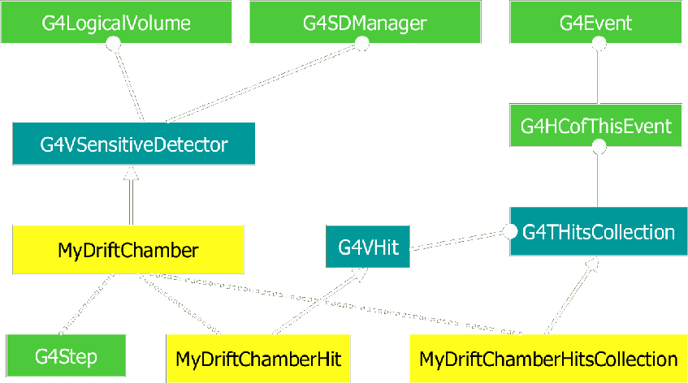
II. Sensitive detector
Class diagram

