Slide 1

Particles and Physics Processes
Geant4 Collaboration
KEK/CRC

Slide 2

Contents
Particles
Process Interface
Production cuts
User limits

Slide 3
particles

Slide 4
Structure from G4Track to process
“snapshot” of a particle state
  position, time, etc
propagated by the tracking
handled by G4 kernel
G4Track
G4DynamicParticle
"Dynamic" physical properties of a particle,
  such as momentum, energy, spin, etc.
  representing an individual particle.
G4ParticleDefinition
"Static" properties of a particle
  THE particle type: G4Electron, G4Gamma, …
  charge, mass, life time, decay channels, etc.
G4ProcessManager
manage process list
each concrete physics process
Process 1
configured by users
a.k.a. user physics list
Process 1
Process 1
Process 1

Slide 5
Process interface

Slide 6
Process Interface
Abstract base class (G4VProcess) defining the common interface of all processes in Geant4:
  derived by all physics processes
  Particle transportation is a process as well, by which a particle interacts with geometrical volume boundaries and field of any kind.
  Users can define their own process class deriving from G4VProcess.
Each particle has its own list of applicable processes (G4ProcessManager).
  At each step, all processes listed are invoked to get proposed physical interaction lengths.
  The process which requires the shortest interaction length
  limits the step.
process-1
process-2
process-3

Slide 7
Process types in Geant4
Three kinds of processes:
  AtRest process:
    e⁺ annihilation …
  AlongStep process:
    To describe continuous processes,
    occuring along the path of the particle,
    ionisation, multiple scattering, ...
  PostStep process
    To describe point-like reactions
    decay in flight, compton scattering, ...
A process can implement any combination of these types:
  e.g. decay = AtRest + PostStep
AlongStep
PostStep

Slide 8
G4VProcess: action methods
Each action defines two mandatory (virtual) methods:
  GetPhysicalInteractionLength()
    used to limit a step:
    the process triggers an interaction,
    or any other reasons, like fraction of energy loss, geometry boundary, user’s limits …
  DoIt()
    implements the actual action to be applied on the track
    the related production of secondaries
Other useful methods
  G4bool IsApplicable(const G4ParticleDefinition &)
    used to check if a process can handle a given particle type

Slide 9
Sequence of processes for a particle travelling
At the beginning of the step, determine the step length
  define the step length as the smallest of the lengths among :
    All AlongStep/GetPhysicalInteractionLenght()
    All PostStep/GetPhysicalInteractionLength()
Apply all AlongStepDoIt() actions, at once:
  changes are computed from particle state at the beginning of the step,
  accumulated in the G4Step,
  then applied to the G4Track, from the G4Step.
Apply PostStepDoIt() actions sequentially:
  apply PostStepDoIt() of the process which limit the step

Slide 10
Physics List
G4ProcessManager maintains three vectors of processes (for AtRest/AlongStep/PostStep)
These vectors are provided by users
a.k.a. “Physics List”.
  a list of processes to be taken into account
  process ordering

Slide 11
A word about process ordering
Ordering of following processes is critical:
  Assuming n processes, the ordering of the AlongGetPhysicalInteractionLength() of the last processes should be:
    [n-2] multiple scattering
    [n-1] ionization
    [n] transportation
Why?
  Processes return a true path length.
  Multiple scattering virtually folds up this true path length into a shorter geometrical path length.
  Based on this new length, the transportation can geometrically limits the step.
Other processes ordering usually does not matter.
×

Slide 12
production cuts

Slide 13
Threshold for Secondary Production (1)
Every simulation developer must answer the question:
  At what energy do I stop tracking particles?
This is a balancing act
  need to go low enough to get the physics interested in
  can't go too low because some processes have infrared divergence causing much CPU-time consumption.
The traditional Monte Carlo solution is to impose an absolute cut-off in energy:
  particles are stopped when this energy is reached
  remaining energy is dumped at that point
13

Slide 14
Threshold for Secondary Production (2)
But, such a cut may cause imprecise stopping location and deposition of energy
There is also a particle dependence
  range of 10 keV γ in Si is a few cm
  range of 10 keV e⁻ in Si is a few microns
And a material dependence
  suppose you have a detector made of alternating sheets of Pb and plastic scintillator
  if the cut-off is OK for Pb, it will likely be wrong for the scintillator which does the actual energy deposition measurement
14

Slide 15
Threshold for Secondary Production (3)
Geant4 solution: impose a production threshold
  this threshold is a distance, not an energy
  default = 1 mm
  a charged particle loses energy by producing secondary electrons or gammas
  if the particle no longer has enough energy to produce secondaries which travel at least 1mm, two things happen:
    discrete energy loss ceases (no more secondaries produced)
    the particle is tracked down to zero energy using continuous energy loss
Stopping location is therefore correct.
Only one value of production threshold distance is needed for all materials
  correspond to different energies depending on material.
15

Slide 16
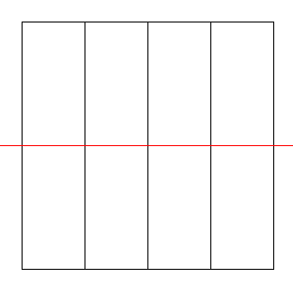
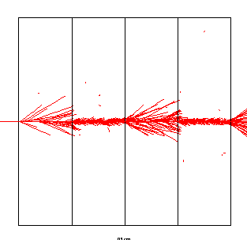
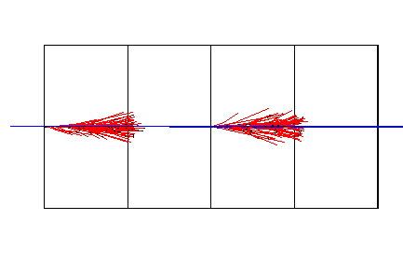
Production Threshold vs. Energy Cut
500 MeV p in LAr-Pb sampling calorimeter
Cut = 2 MeV
Cut = 450 keV
Production cut =1.5 mm
16

Slide 17
User limits

Slide 18
G4UserLimits
User limits are artificial limits affecting to the tracking.
  G4UserLimits( G4double ustepMax = DBL_MAX,
  G4double utrakMax = DBL_MAX,
  G4double utimeMax = DBL_MAX,
  G4double uekinMin = 0.,
  G4double urangMin = 0. );
  fMaxStep; // max allowed Step size in this volume
  fMaxTrack; // max total track length
  fMaxTime; // max global time
  fMinEkine; // min kinetic energy remaining (only for charged particles)
  fMinRange; // min remaining range (only for charged particles)
  Blue : affecting to step / : affecting to track
You can set user limits to logical volume and/or to a region.
  User limits assigned to logical volume do not propagate to daughter volumes.
  User limits assigned to region propagate to daughter volumes.
  If both logical volume and associated region have user limits, those of logical volume win.

Slide 19
Processes co-working with G4UserLimits
In addition to instantiating G4UserLimits and setting it to logical volume/region, you have to assign the following processes to particle types you want to affect.
Limit to step:
  G4StepLimiter process must be defined to affected particle types.
Limits to track:
  G4UserSpecialCuts process must be defined to affected particle types.

