Slide 1

Hands-on Work 2
Geant4 Collaboration
KEK/CRC

Slide 2
Hand-on Work -2
The first Geant4 user application
Practice on basic geometry implementation
  implementation of detector construction class
  volume placement
  collision detection
How to use particle gun

Slide 3
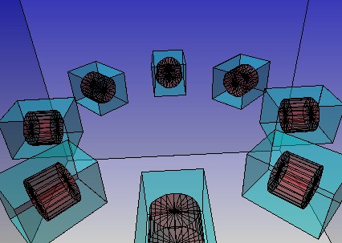
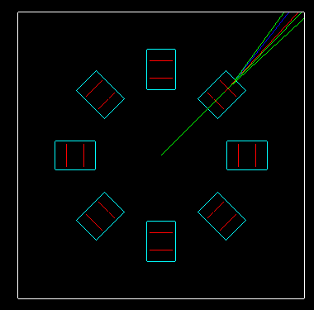
Exercise
http://www-geant4.kek.jp/g4users/
g4tut07/exercise-2.html
The first Geant4 user application
  interactive session using macro file
Implement simple geometry
  8 boxes circularly placed around the Z axis.
  a cylinder inside a box
  Step by step implementation
  Collision detection
Usage of particle gun

