Slide 1

Hands-on Work 1
Geant4 Tutorial @ Japan 2007
Geant4 Collaboration
KEK/CRC

Slide 2
Hand-on Work -1
How is your installation ?
Playing with novice examples : N01, N03,…

Slide 3
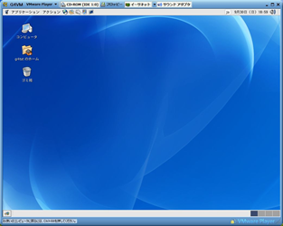
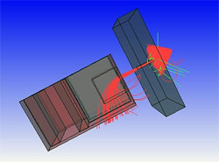

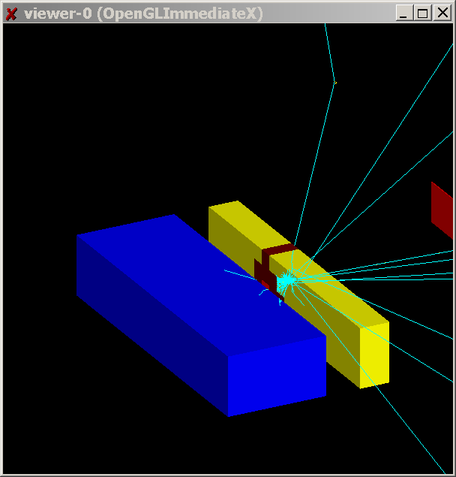
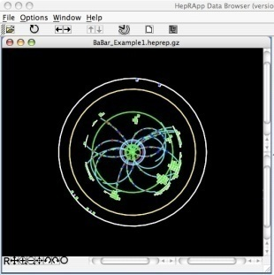
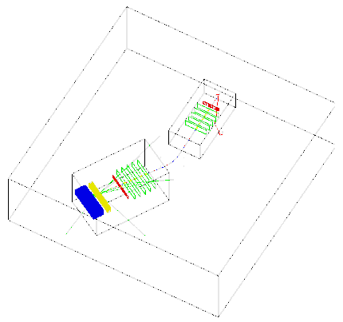
Your Installation
Windows XP/Vista users
  http://www-geant4.kek.jp/g4users/
  g4tut07/install-win.html
  Virtual machine on VMware Player (Free)
    Scientific Linux 4.5
    user name: g4tut, password: $g4tut$
  Pre-installed packages
    CLHEP, ROOT, gLite
    Geant4
      pre-build library
      data files
      examples
    Geant4 visualization tools
      DAWN, VRML view, WIRED3

Slide 4
Practical installation guide for Linux
  http://www-geant4.kek.jp/g4users/
  g4tut07/install-liux.html
  If you will install Geant4 and its related packages by yourself, follow the procedures described here.
    CLHEP, Geant4, Visualization tools, ROOT
  Another useful guide
  http://geant4.slac.stanford.edu/installation/

Slide 5
Let’s play with examples

Slide 6
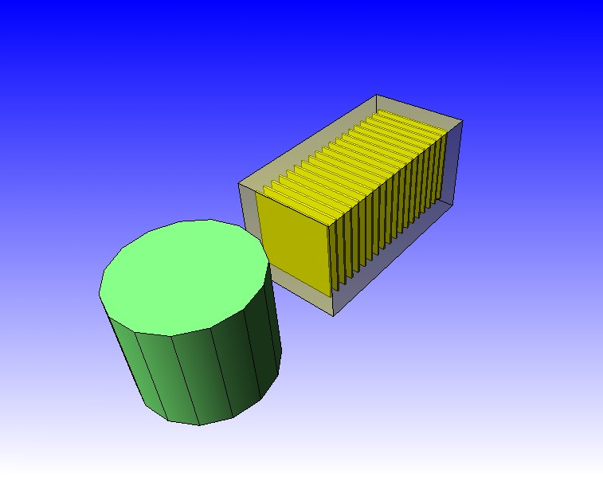
Novice example N01
Let’s start with this example as warm-up
Fixed geometry
  Ar gas mother volume with Al cylinder and Pb block with Al slices
Incident particle is a geantino
  no physics interactions
  only the transportation process is enabled
Hard coded batch job and verbosity

Slide 7
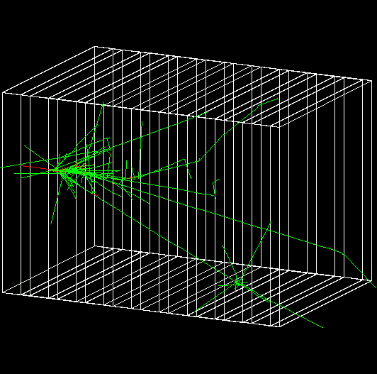
Novice Example N03
Let’s play with this example.
Sampling calorimeter with layers of Pb absorber and liquid Ar detection gaps (replicas)
Exhaustive material definitions
Command interface
Randomization of incident beam
All EM processes + decay, with separate production cuts for γ, e+, e-
Detector response: E deposit, track length in absorber and gap
Visualization tutorial
Random number seed handling

Slide 8
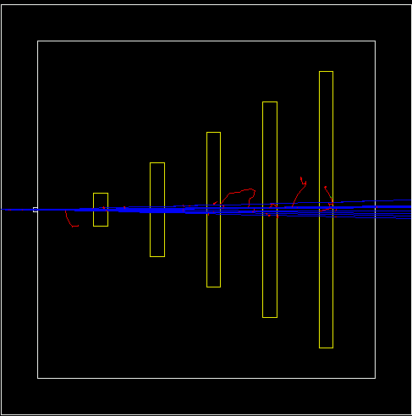
Novie Example N02
Pb target, Xe gas chambers (parameterized volumes)
All EM processes + decay including charged leptons and charged hadrons
Detector response
  Trajectories and chamber hit collections may be stored
Visualization of detector and event
Command interface introduced
  Can change target, chamber materials, magnetic field, incident particle type, momentum, etc. at run time

Slide 9
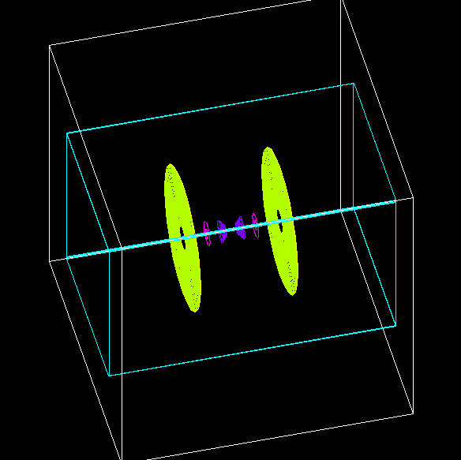
Novie Example N04
Simplified collider detector
  all kinds of volume definitions
Magnetic field
PYTHIA primary event generator
  Higgs decay by Z0, lepton pairs
Packaged physics list (QGSP)
Event filtering by using stacking mechanism

Slide 10
Novice Example N05
Fast simulation with parameterized showers
  EM showers (derived from G4VFastSimulationModel)
  Pion showers (for illustration only – not used)
EM physics only
  Use of G4FastSimulationManagerProcess
Simplified collider detector geometry
  Drift chamber
  EM, hadronic calorimeter
  Ghost volume

Slide 11
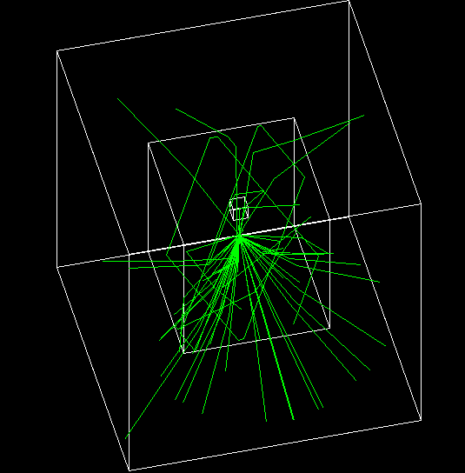
Novice Example N06
Water Cerenkov detector with air “bubble”
Materials
  Specification of optical properties
  Specification of scintillation spectra
Physics
  Optical processes
  Generation of Cerenkov radiation, energy loss collected to produce scintillation

Slide 12
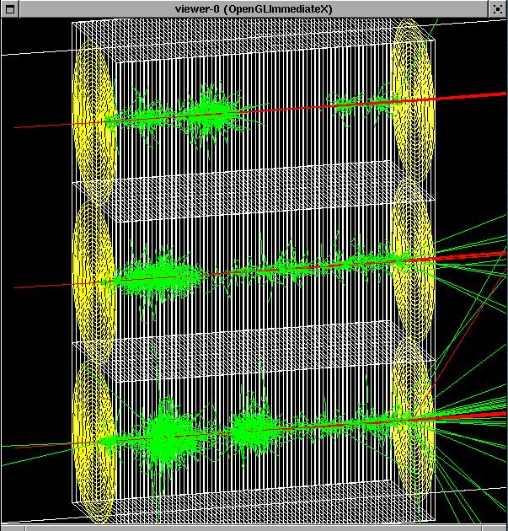
Novice Example N07
3 simplified sandwich calorimeters (Pb, Al, Ar)
Cylindrical ghost volume for scoring
Run-based (as opposed to event-based) hit accumulation
Changing geometries without rebuilding world
Setting different secondary production cuts for each calorimeter using G4Region

