Slide 1

Geant4 Overview and Kernel
Geant4 Tutorial @ Japan 2007
Geant4 Collaboration
KEK/CRC

Slide 2
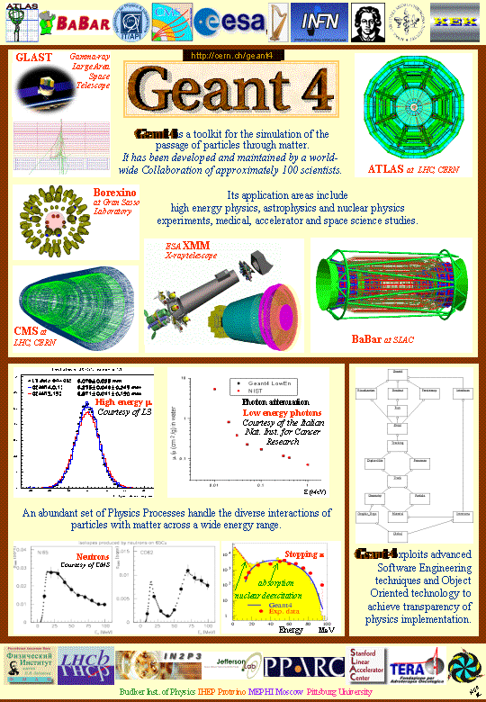

Contents
Introduction
Kernel structure
User support

Slide 3
Introduction
What is Geant4?
User applications
Basic Concept in Monte Carlo Simulation

Slide 4
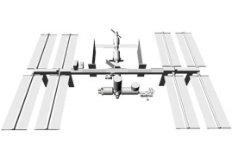
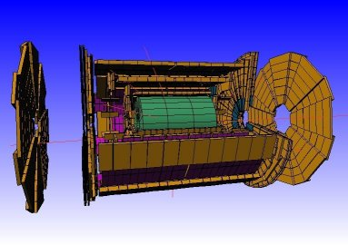
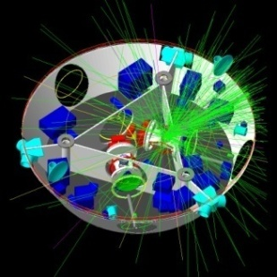
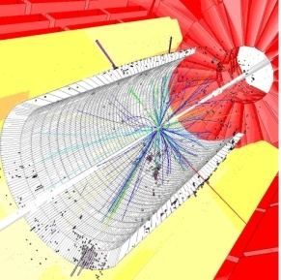
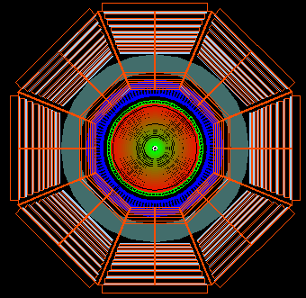
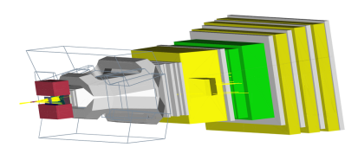
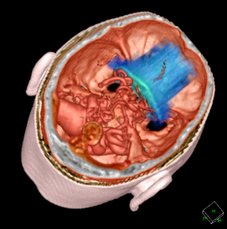
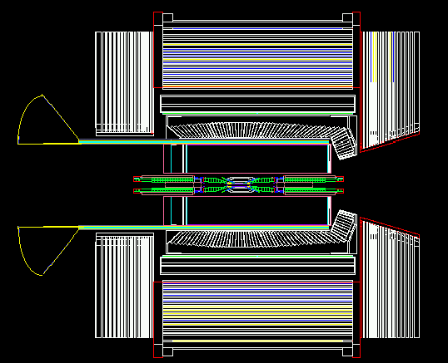
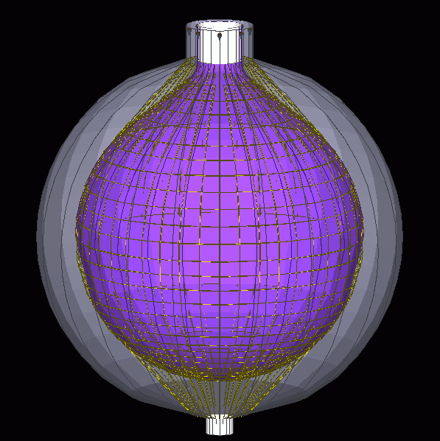
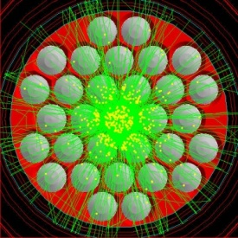
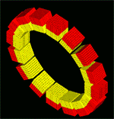
What is Geant4?
A world-standard toolkit for HEP detector simulation
  Successor of GEANT3
  A successful project to re-design a HEP software using an Object-Oriented approach (C++)
    for LHC experiments
A large degree of functionality and flexibility
  Many application fields beyond HEP
  A variety of requirements from
    HEP experiments, under ground experiments,
    cosmic ray physics, astrophysics,
    accelerator engineering, shielding studies,
    space science and medical applications

Slide 5




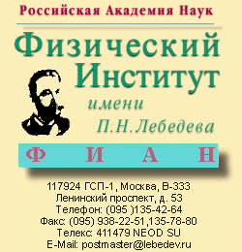
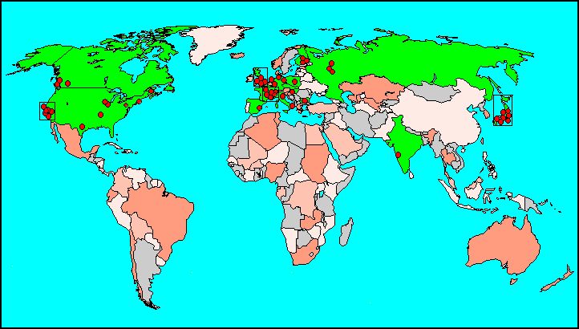










Geant4 Collaboration
Collaborators also from non-member institutions, including
Budker Inst. of Physics
IHEP Protvino
MEPHI Moscow
Pittsburg University

Slide 6
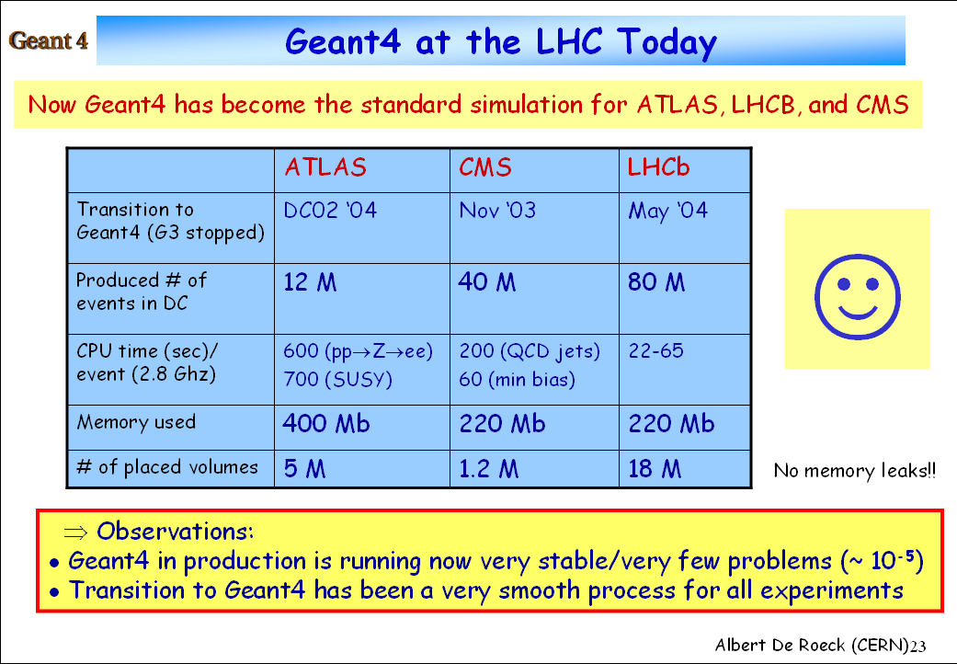

Slide 7
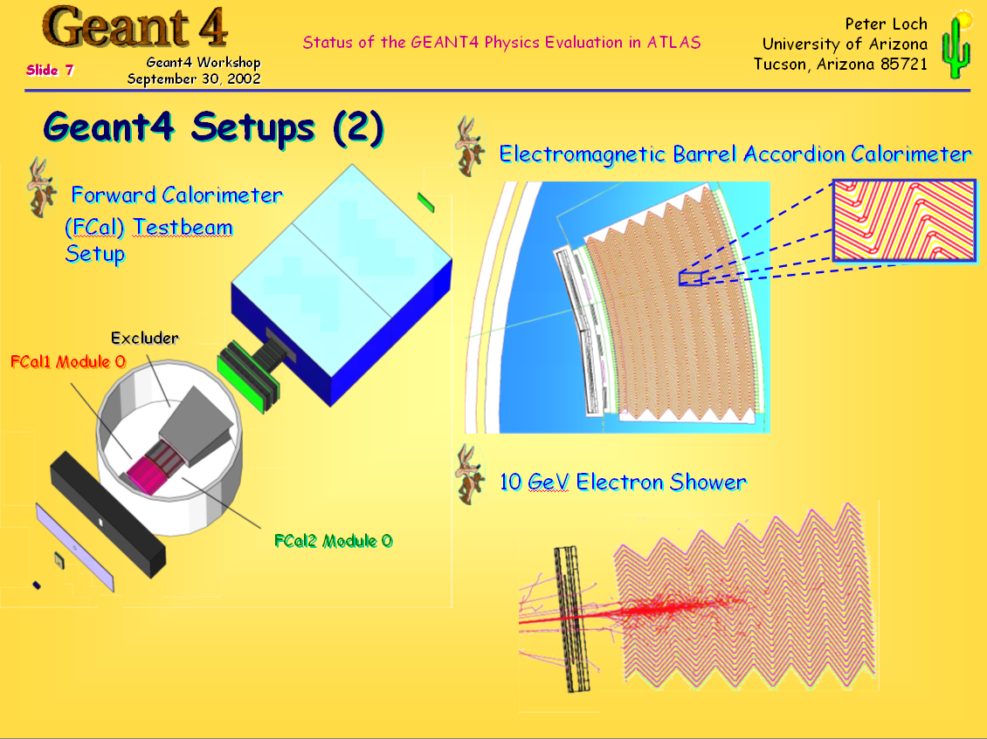

Slide 8
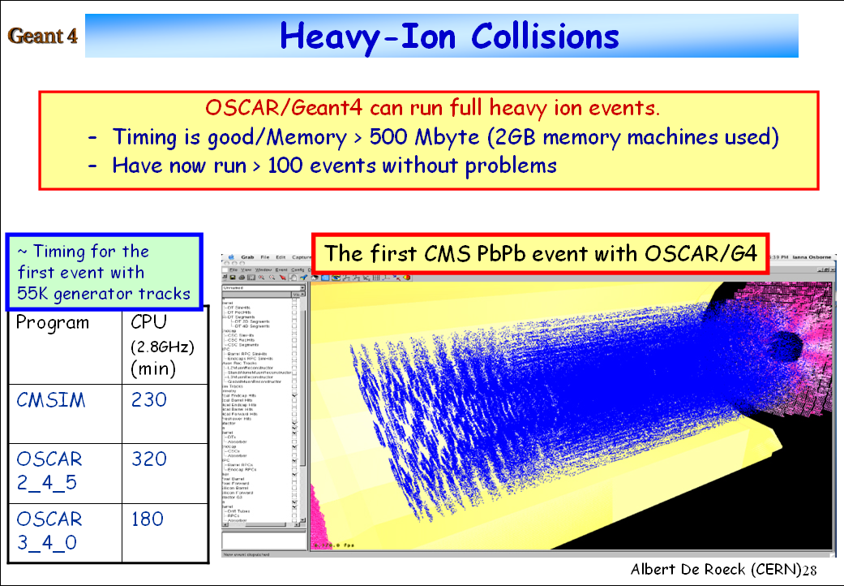

Slide 9
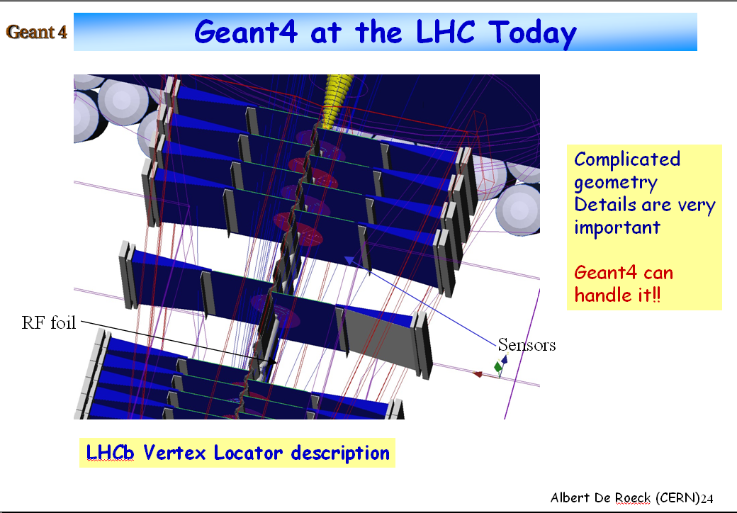

Slide 10
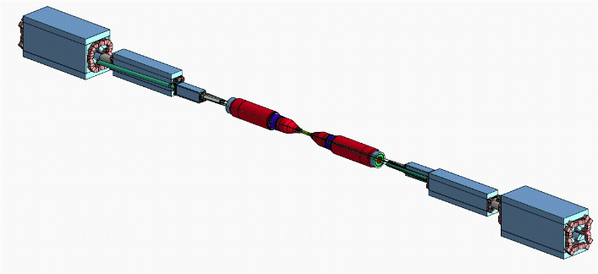
BaBar
BaBar at SLAC is pioneer in the use of Geant4
  Started in 2000
  Simulated 10¹⁰ events so far
  Produced at 20 sites in North America and Europe
  Current average production rate 6.1 x 10⁷ events/week

Slide 11
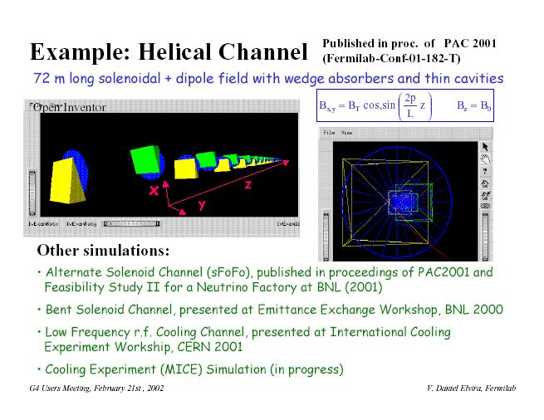
Geant4 for beam transportation

Slide 12
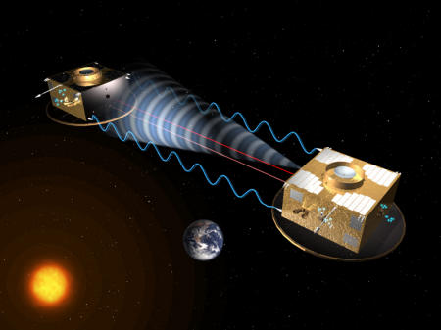
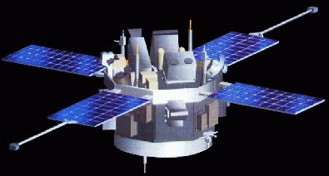
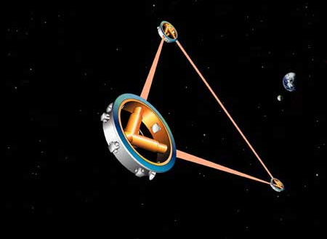
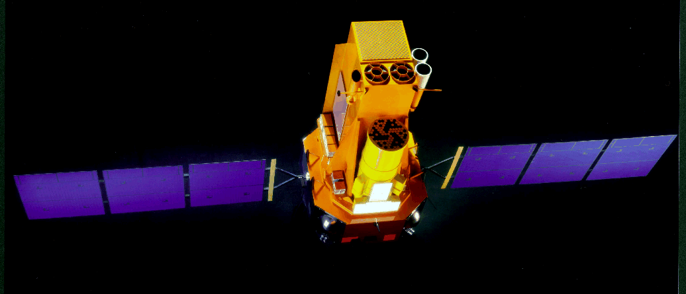
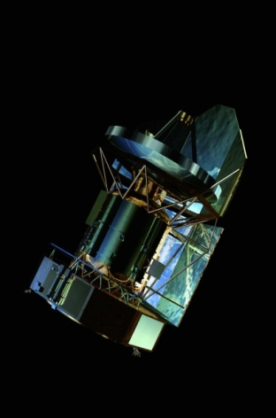
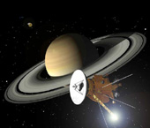
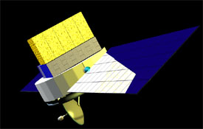
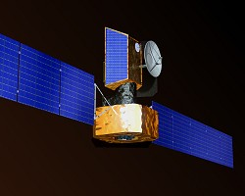
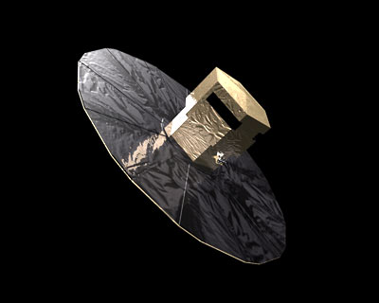


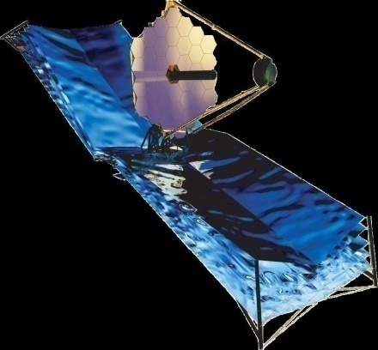
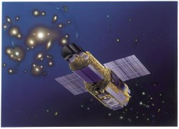
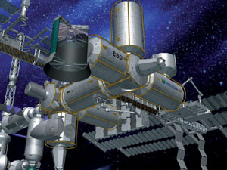
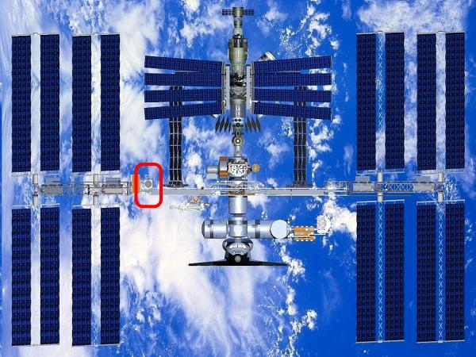
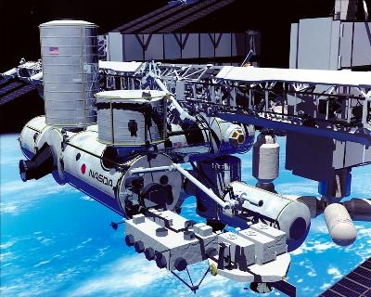

Smart-2
INTEGRAL
ACE
Cassini
LISA
Herschel
GLAST
Bepi Colombo
SWIFT
Astro-E2
XMM-Newton
GAIA
JWST
EUSO
ISS Columbus
AMS
MAXI

Slide 13
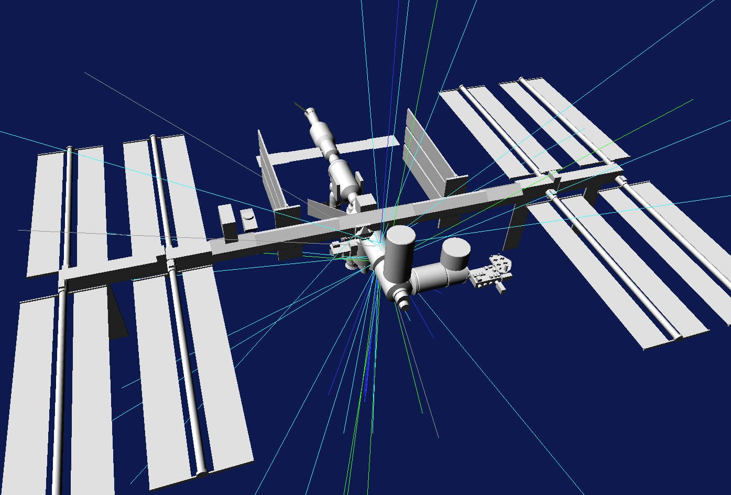

Slide 14
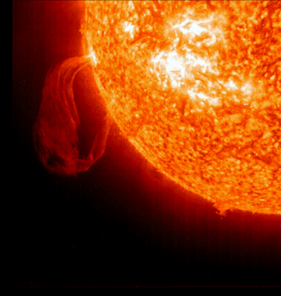
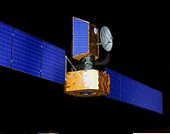
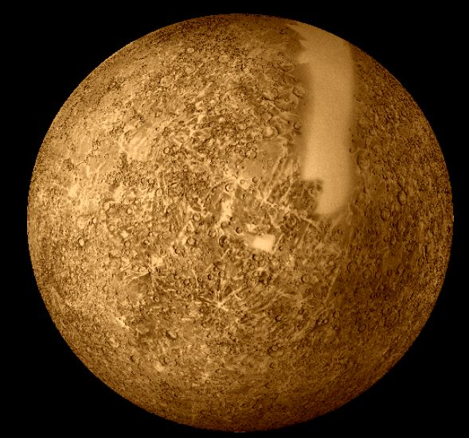
Bepi Colombo: X-Ray
Mineralogical Survey of Mercury
Space Environments
and Effects Section

Slide 15
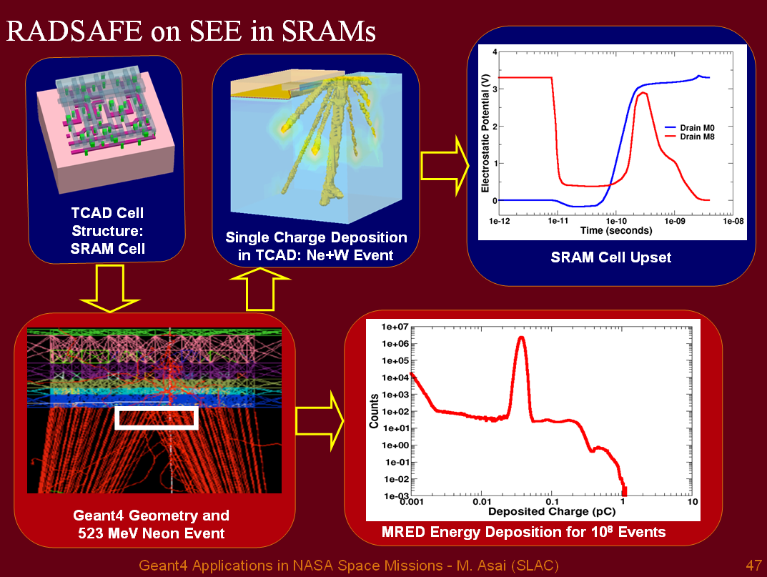

Slide 16
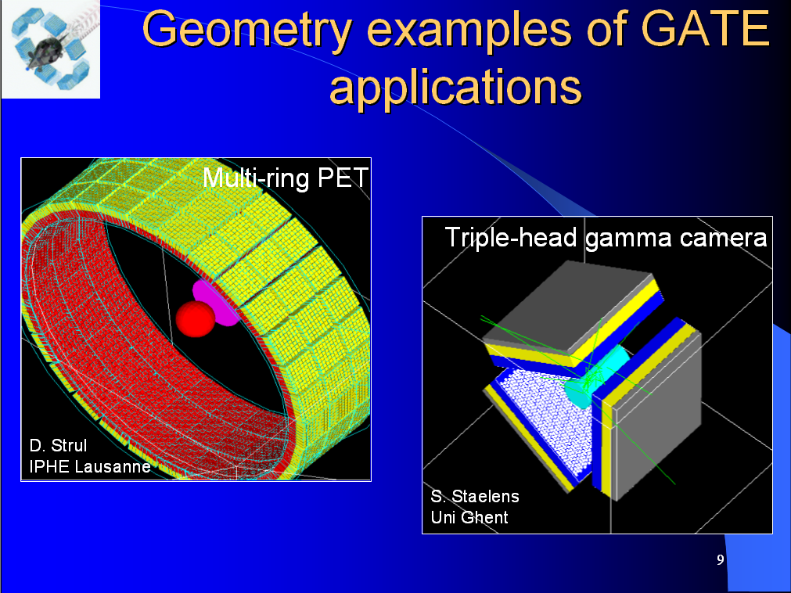

Slide 17
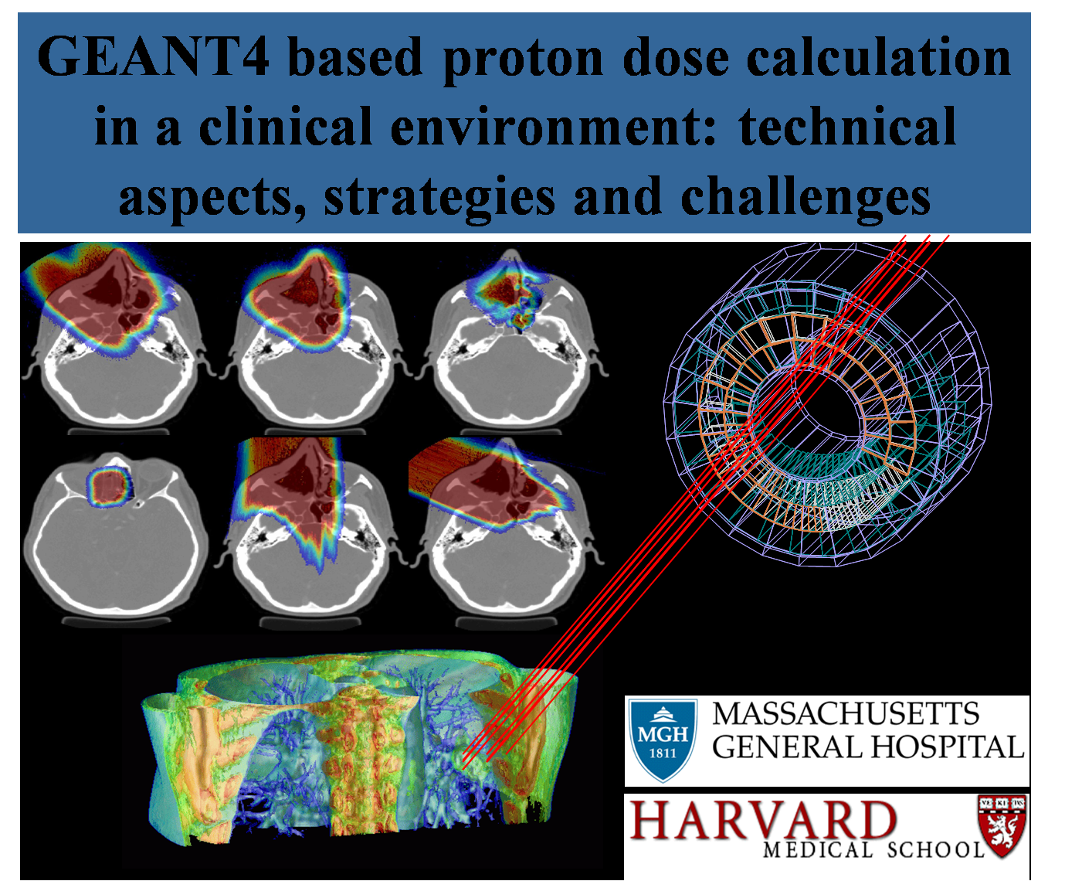

Slide 18
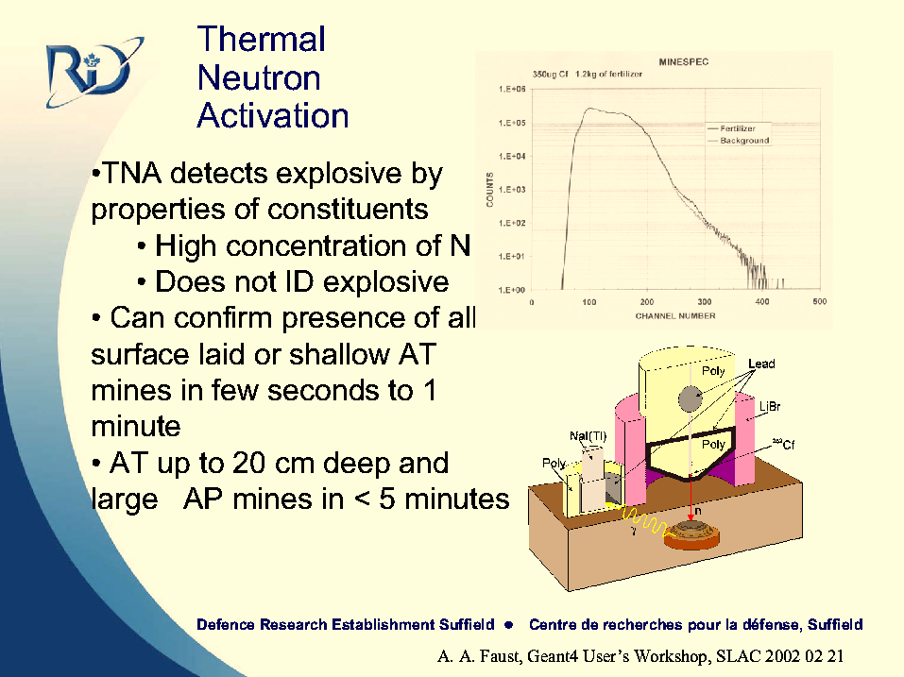

Slide 19
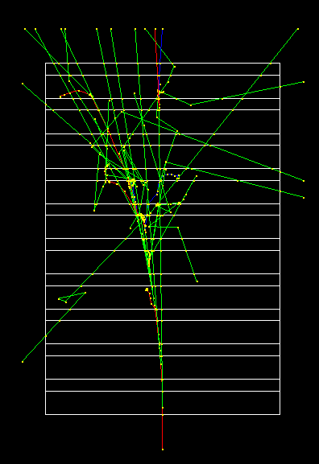
GEometry ANd Tracking
General characteristics of detector simulation programs:
  specifying the geometry of a detector
  transporting (tracking) particles injected to the detector
  simulating the particle interactions in matter based on the Monte Carlo technique

Slide 20
MC Simulation – Exponential law
f(x) : probability of not having interaction
after a distance x
Microscopically,
wdx : prob. of having interaction in [x, x+dx]
  w= N_{at}σ : # atoms/unit x cross section
  λ=1/w : interaction length / lifetime
f(x+dx)= f(x) (1-wdx)
f(x)= exp(-x/λ)
γ
γ
x
Compton scattering
e⁻

Slide 21
MC Simulation – How to randomize
Interaction Probability in [x, x+dx]:
P(x)dx = f(x) wdx
    P(x) : Probability density function
Interaction Point (x) can be generated by
  n_{λ} = x/λ = - ln(r), with r uniform in [0, 1]

Slide 22
Practically, …
  λ and x are dependent of materials
  One can define the number of interaction length :
  n_{λ} is independent of materials !
In a MC program,
  sample n_{λ} at origin of the track (fate) : n_{λ} = - ln(r)
  update elapsed n_{λ} along the track : n_{λ} = n_{λ} – dλ_{i} / λ_{i}
  generate an interaction when n_{λ} = 0
  n_{λ} is managed by each process
x
x₁
x₂
x₃

Slide 23
Kernel structure
Basic concepts

Slide 24


Terminology a.k.a. Jargons
Analogy to the real HEP experiment / the real world (OO)
Run, Event, Track, Step, Step Point
  XXXManager, XXXUserAction,…
DetectorConstruction
  LogicalVolume, PhysicalVolume, Parameterized, …
Primary, Vertex
  PrimaryGeneratorAction, ParticleGun, …
Process
  At rest, Along Step, Post Step
  PhysicsList, …
  ParticleDefinition, Dynamic Particle, …
  Cut = Production Threshold
Sensitive Detector, Hit, Hits Collection
Trajectory / Trajectory Point
...

Slide 25
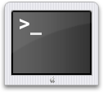


Geant4 Overall Structure
Geant4 Kernel
Interfaces
Run
Intercoms
Event
Digits/hits
Visualization
Tracking
Track
Geometry
Processes
Particles
Materials

Slide 26
Run in Geant4
G4RunManager class manages processing a run.
  A run is represented by G4Run class, which has summary results of each run.
  Within a run, users cannot change
    detector setup
    settings of physics processes
  Conceptually, a run is a collection of “events” (G4Event).
  G4UserRunAction class is an optional user hook.
A run of Geant4 is started by saying “Beam On”.
  Practically, we call “run beam on” as executing a UI command “/run/beamOn”.
  At the beginning of a run, geometry is optimized for navigation and cross section tables are calculated according to materials in the geometry.

Slide 27
Event in Geant4
An event is the basic unit of simulation.
G4EventManager class manages processing an event.
  At the beginning of processing, primary tracks are generated and pushed into a stack.
  A track is popped up from the stack one by one and “tracked”.
    Resulting secondary tracks are also pushed into the stack.
  When the stack is empty, event processing is over.
  G4UserEventAction is an optional user hook.
G4Event class represents an event.
  List of primary vertices and particles (as input)
  Hits and Trajectory collections (as output)
Last-In Fast-Out
Secondary
Secondary
Secondary
Secondary
Secondary
Primary
Primary
Primary
Primary
Track Stack

Slide 28
Run/Event
Hierarchy/Flow
Manage run flow
G4RunManager
G4RunManager::BeamOn()
user hook methods
G4UserRunAction::BegeinOfRunAction()
G4Run
run information
run id
# events, etc
G4UserRunAction::EndOfRunAction()
Manage event loop
G4EventManager
G4UserEventAction::BegeinOfEventAction()
G4Event
event information
event id
primary vertex, etc
Tracking
G4UserEventAction::EndOfEndAction()

Slide 29
Tracking a particle,
Track, Step, Step Point, and Trajectory
snapshot information
e.g. position
Track
PostStep Point
Step
PreStep Point
A pair of step points
delta information (e.g. ΔE)
Time Line
Trajectory
a collection of trajectory points
mainly used for visualization
Primary Vertex

Slide 30
Track in Geant4
Track is a snapshot of a particle.
  It has physical quantities of current instance only, being updated by steps.
  No track object persists at the end of event.
    For recording tracks, use trajectory objects.
G4TrackingManager manages processing a track
  A track is represented by G4Track class.
  G4UserTrackingAction is an optional user hook.

Slide 31
Step/Step Point in Geant4
Step has two points (G4StepPoint, pre-/post- step point) and also “delta” information of a particle
  energy loss, TOF spent by the step, etc.
  In case a step is limited by a volume boundary, the post-step point physically stands on the boundary, but logically belongs to the next volume.
    Boundary processes such as transition radiation or refraction require material information in both volumes
G4SteppingManager class manages processing a step
  a step is represented by G4Step class.
  G4UserSteppingAction is an optional user hook.
Volume-A
Volume-B
PostStep Point
PreStep Point

Slide 32
Trajectory and Trajectory Point
G4Trajectory class copies some of G4Track information.
G4TrajectoryPoint class copies some of G4Step information.
  Track does not keep its trace.
  G4Trajectory has a collection of G4TrajectoryPoint.
  Given G4Trajectory/G4TrajectoryPoint objects persist until the end of an event.
  G4Event has a collection of G4Trajectory objects.
    /tracking/storeTrajectory must be set to 1.
  They are mainly used for visualization.

Slide 33
Track status
At the end of each step, the state of a track may be changed.
  The user can also change the status in UserSteppingAction/UserStackingAction.
  Statuses shown in blue are artificial, i.e. Geant4 kernel does not set them.
fAlive
  Continue the tracking.
fStopButAlive
  The track has come to zero kinetic energy, but still “AtRest” process to occur.
fStopAndKill
  The track has lost its identity because it has decayed, interacted or gone beyond the world boundary.
  used for forcedly killing an unnecessary track
fKillTrackAndSecondaries
  Kill the current track and also associated secondaries.
fSuspend
  Suspend processing of the current track and push it and its secondaries to the stack.
fPostponeToNextEvent
  Postpone processing of the current track to the next event.
  Secondaries are still being processed within the current event.

Slide 34
Step status
Step status is attached to G4StepPoint to indicate why that particular step was determined.
  Use “PostStepPoint” to get the status of this step.
  “PreStepPoint” has the status of the previous step.
  fWorldBoundary
    Step reached the world boundary
  fGeomBoundary
    Step is limited by a volume boundary except the world
  fAtRestDoItProc, fAlongStepDoItProc, fPostStepDoItProc
    Step is limited by a AtRest, AlongStep or PostStep process
  fUserDefinedLimit
    Step is limited by the user Step limit
  fExclusivelyForcedProc
    Step is limited by an exclusively forced (e.g. shower parameterization) process
  fUndefined
    Step not defined yet
  If you want to identify the first step in a volume, pick fGeomBoudary status in PreStepPoint.
  If you want to identify the step getting out of a volume, pick fGeomBoundary status in PostStepPoint.

Slide 35
Geant4 as a state machine
Geant4 has 6 application states.
  G4State_PreInit
    Material, Geometry, Particle and/or Physics Process need to be initialized/defined
  G4State_Idle
    Ready to start a run
  G4State_GeomClosed
    Geometry is optimized and ready to process an event
  G4State_EventProc
    An event is processing
  G4State_Quit
    (Normal) termination
  G4State_Abort
    A fatal exception occurred and program is aborting
PreInit
initialize
Idle
beamOn
exit
GeomClosed
Run
(event loop)
Quit
EventProc
Abort

Slide 36
User support
Documentations
User support process
License

Slide 37
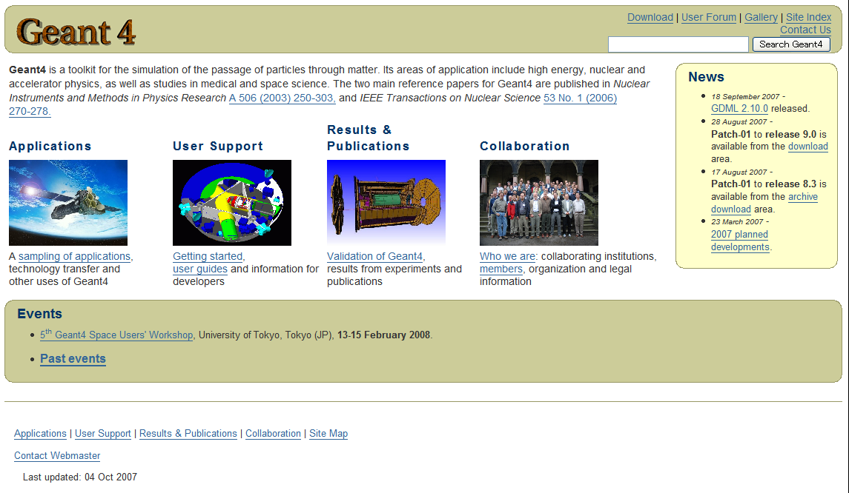
Geant4 Web Pages
Download from here
Reference
http://geant4.web.cern.ch/geant4

Slide 38
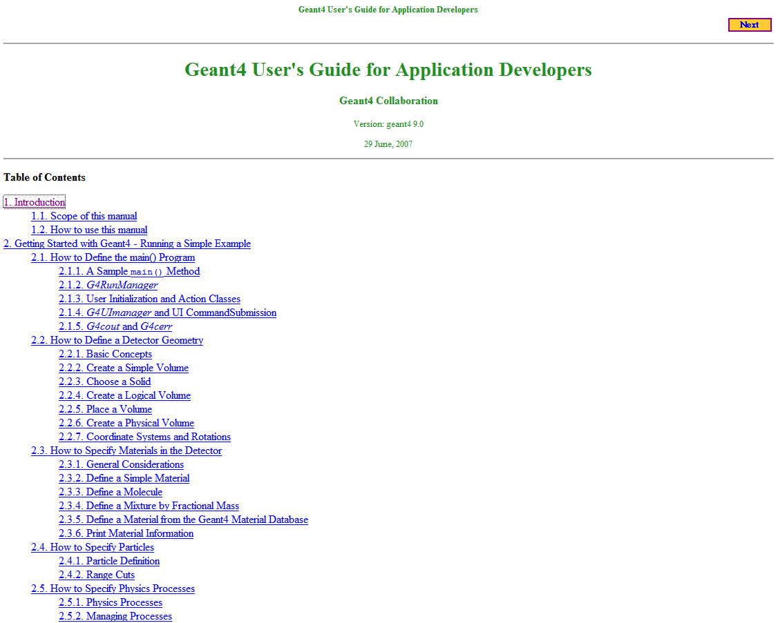
Geant4 Documents
Introduction of Geant4
Installation Guide
User's Guide: For Application Developers
  You must read it!!
User's Guide: For Toolkit Developers
Physics Reference Manual
Software Reference Manual

Slide 39


Installation Guide
http://geant4.web.cern.ch/geant4/G4UsersDocuments/
UsersGuides/InstallationGuide/html/index.html
List of required software
  C++ compiler, CLHEP, GNU make, Geant4 toolkit
  choices for visualization software
How to install on Linux
Tips for installing on Windows
SLAC team provides a good practical installation guide: http://geant4.slac.stanford.edu/installation/
In the practical viewpoint, we recommend Geant4 on

Slide 40
Application Developper Guide
http:// geant4.web.cern.ch/geant4/G4UsersDocuments/
UsersGuides/ForApplicationDeveloper/html/index.html
Most important document both for novice & advanced users.
  Step-by-step tutorial for novice users
  Describes how to set up and run a simulation application with a lot of example codes
  You should read this first if you are new to G4.
Intended as an overview of the toolkit, not an exhaustive treatment. For more details:
  Physics Reference Manual
  Toolkit Developers Guide

Slide 41
Physics Reference Manual
http://geant4.web.cern.ch/geant4/UserDocumentation/
UsersGuides/PhysicsReferenceManual/html/
PhysicsReferenceManual.html
Dedicated to the detail description of the physics model used in each Geant4 interaction process.
  separate physics topics from how to use the toolkit
  Dedicated to physics models, theories, etc
    There are no C++ codes.
    You should read this when you start to wonder what is going on behind the scene.

Slide 42
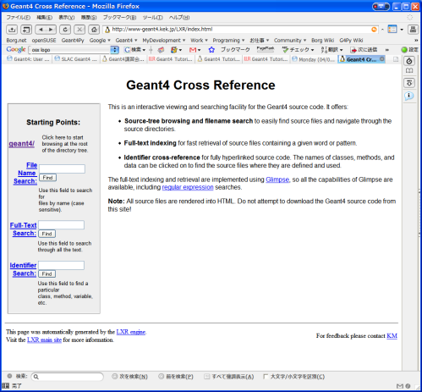
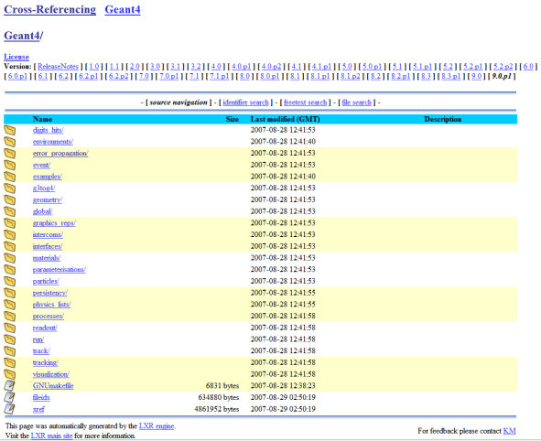
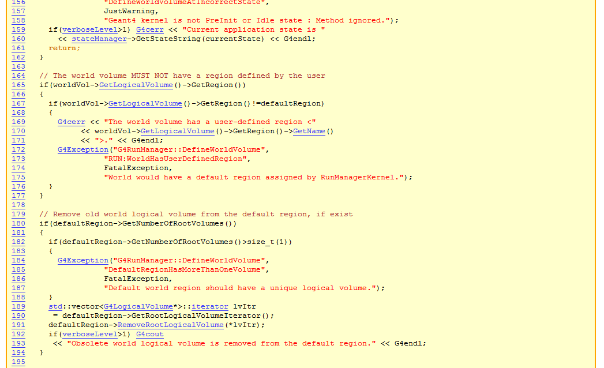
LXR Code Browser
http://www-geant4.kek.jp/LXR/
Search the entire Geant4 source trees by
  filename (e.g. G4Track.hh)
  text
  identifier
Source files fully hyper-linked to classes and methods;
  tells where classes and methods are defined
  also where they are referenced

Slide 43
User Supports
Geant4 Collaboration offers extensive user supports.
  Technical Forum
  Users workshops and Tutorial courses
  HyperNews and mailing list
  Problem tracking system
  Daily “private” communications

Slide 44
Technical Forum
The Technical Forum is open to all interested parties
  To be held at least 4 times per year
The purpose of the forum is to:
  Achieve, as much as possible, a mutual understanding of the needs and plans of users and developers.
  Provide the Geant4 Collaboration with the clearest possible understanding of the needs of its users.
  Promote the exchange of information about physics validation performed by Geant4 Collaborators and Geant4 users.
  Promote the exchange of information about user support provided by Geant4 Collaborators and Geant4 user communities.

Slide 45
Geant4 Users/Collaboration Workshop and Tutorials
Users/Collaboration workshops were held.
  Catania - Oct. 2004
  Bordeaux - Nov.2005
  Lisbon - Oct. 2006
  Manchester - Sep. 2007
  Kobe - Sep. 2008
Local workshops/tutorials were organized various places for different user communities.
  SLAC/FNAL/ Jefferson : users workshops, tutorials
  NASA/ESA : space users workshops
  KEK : users workshops, tutorials
  IN2P3: tutorials
  INFN : tutorials
  IEEE/MIC : tutorials
  …

Slide 46
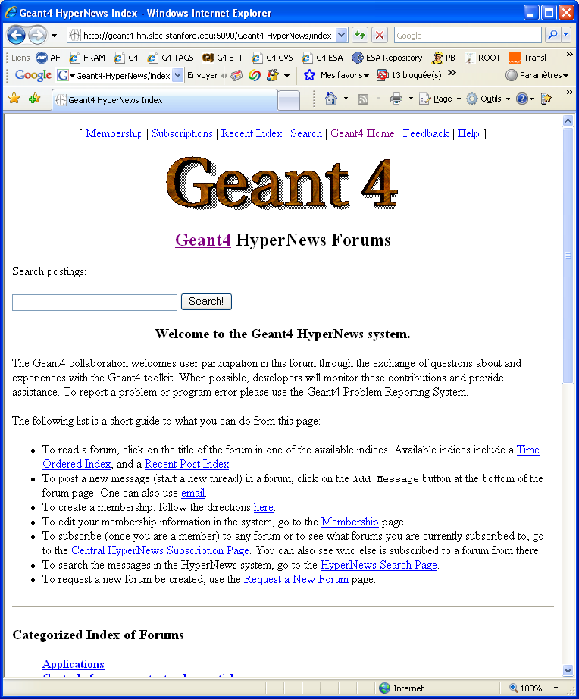
HyperNews User Forum
http://geant4-hn.slac.stanford.edu:5090/ Geant4-HyperNews/index
Discuss problems with other users, post questions for experts, etc.
  18 forums roughly based on Geant4 categories
  4 forums for specific application areas
  (education, medicine, space, industry)
  New forums may be requested by users

Slide 47

Geant4/Bugzilla
http://bugzilla-geant4.kek.jp/
Geant4 Problem Tracking System based on Bugzilla
  Archives and tracks details of problems reported by users and developers

Slide 48


Geant4 Reference Papers
The two main reference papers for Geant4:
Geant4—a simulation toolkit
Nuclear Instruments and Methods in Physics Research Section A: Volume 506, Issue 3, 1 July 2003,
Pages 250-303
Geant4 developments and applications
Nuclear Science, IEEE Transactions
Publication Date: Feb. 2006
Volume: 53, Issue: 1, Part 2
On page(s): 270- 278

Slide 49

The Geant4 License
The collaboration presets the Geant4 license.
  Makes clear the user’s wide-ranging freedom to use, extend or redistribute Geant4, even as part of some for-profit venture.
  The license was released along with the latest Geant4 release 8.1.
  Simple enough that you can read and understand it.
http://cern.ch/geant4/license/

Slide 50









Flexibility of Geant4
Last slide
Many types of geometry descriptions
  CSG solids, BREP and boolean solids
  Placement, replica, divided, parameterized, reflected and grouped
  XML description
Wide coverage of physics processes
  EM, hadron, ion, optical photon, decay, shower parameterization
  event biasing, and your own processes
  Model mixture of theory-driven, data-driven and parameterized
Everything is open to the user
  Choice of physics processes/models
  Choice of analysis/user interface/visualization technologies
Geant4 is a tool kit, NOT a simulation black box!!

