Slide 1

Advanced Topics and Recent Topics
Koichi Murakami
KEK/CRC

Slide 2

Outline
More advanced features
  Supplemental about packaged physics list
  Stack management
  Shower parameterization
  Pre-assigned decay
  Python interface
Reports from Geant4 Collaboration workshop
  Physics validation
  Performance issues
  Recent improvements
Discussion

Slide 3
supplemental about packaged physics list

Slide 4
Hadron models
CHIPS
At rest
Absorption
μ, π, K, anti-p
CHIPS (gamma)
Photo-nuclear, electro-nuclear
High precision neutron
Evaporation
Fermi breakup
Pre-
compound
FTF String (up to 20 TeV)
Multifragment
QG String (up to 100 TeV)
Photon Evap
Binary cascade
Rad. Decay
Bertini cascade
Fission
LE pp, pn
HEP ( up to 15 TeV)
LEP
1 MeV 10 MeV 100 MeV 1 GeV 10 GeV 100 GeV 1 TeV

Slide 5
Groups of lists – hadronic options
LHEP using parameterized models
QGS/FTF series replaces parameterized high energy model
  theory driven string model used for pion, protons, neutrons, kaons
  Improved cross-sections
  Better description for stopping particles using CHIPS modeling
  Revised elastic scattering
Variations for modeling at medium and low energies (e.g. QGSP_BIC)
  Cascade model, precompound model, CHIPS, low energy neutron transport

Slide 6
Inventory of Reference PL (G4 8.3)
LHEP
LHEP_EMV
LHEP_BERT
LHEP_BERT_HP
LHEP_BIC
LHEP_BIC_HP
LHEP_PRECO
LHEP_PRECO_HP
LHEP_HP
LHEP_LEAD
LHEP_LEAD_HP
QGSP
QGSP_EMV
QGSP_EMX
QGSP_NQE
QGSP_EMV_NQE
QGSP_BERT
QGSP_BERT_EMV
QGSP_BERT_HP
QGSP_BERT_NQE
QGSP_BERT_TRV
QGSP_BIC
QGSP_BIC_HP
QGSP_HP
QGSP_QEL
QGSC
QGSC_EMV
QGSC_EFLOW
QGSC_LEAD
QGSC_LEAD_HP
LBE
FTFC
FTFP_EMV
FTFP
QBBC
Lists in italic deleted in 9.0

Slide 7
Examples
LHEP:
  fast, for shower simulation in calorimeter
  Paratmeterized modeling for all hadronic interactions
  Standard EM physics
QGSP
  QGS for high energy interaction, using Precompound for nuclear de-excitation
  LEP for low energy ( < 12-25 GeV)
  LHEP models for particles other than proton, neutron, pion, Kaon
  Elastic scattering was changing
  Standard EM physics
QGSP_BERT_HP
  Radiation background studies – good modeling for neutron production and transport
  Usage of LEP reduced by BERT for nucleons, pions, kaons below 10 GeV
  Add HP neutron transport for neutrons < 20MeV
QGSC
  Like QGSP with improved nuclear fragmentation provided by CHIPS
FTFP
  Alternative string model, under revision
QGSP_EMV, LHEP_EMV
  Alternate EM physics, using faster multiple scattering similar to 7.1

Slide 8
Updates in 9.0
Rename components for EM physics
  G4EMStandardPhysics, the default EM option
  G4EMStandardPhysics_option1, used by _EMV variants
    Was G4EMStandardPhysics71
  G4EMStandardPhysics_option2, used by _EMX variants
    Was G4EMStandardPhysics72
Removed obsolete lists
Threshold for use of FTF model lowered to 5GeV
  FTF is under development

Slide 9
Plans
Improve documentation
  draft pages available at http://cern.ch/geant4/support/proc_mod_catalog/physics_lists/physicsLists.shtml
Continue to provide new model developments
  e.g. add quasi-elastic channel for string models
  New options as new (experimental) physics lists
  Adopt mature options
Better integrate physics lists for communities like underground experiments, space users, …

Slide 10
Stack management

Slide 11
Track stacks in Geant4
Last-In Fast-Out
By default, Geant4 has three track stacks.
  "Urgent", "Waiting" and "PostponeToNextEvent"
  Each stack is a simple "last-in-first-out" stack.
  User can arbitrary increase the number of stacks.
ClassifyNewTrack() method of UserStackingAction decides which stack each new coming track to be stacked (or to be killed).
  By default, all tracks go to Urgent stack.
A Track is popped up only from Urgent stack.
Once Urgent stack becomes empty, all tracks in Waiting stack are transferred to Urgent stack.
  And NewStage() method of UsetStackingAction is invoked.
Secondary
Secondary
Secondary
Secondary
Secondary
Primary
Primary
Primary
Primary
Track Stack

Slide 12
Stacking mechanism
primary tracks
User Stacking
Action
Event Manager
Classify
Push
Pop
Stacking
Manager
Process One Track
Push
Urgent
Stack
Pop
secondary or suspended tracks
Push
Push
Waiting
Stack
Postpone To
Next Event
Stack
Tracking
Manager

Slide 13
G4UserStackingAction
User has to implement three methods.
G4ClassificationOfNewTrack ClassifyNewTrack(const G4Track*)
  Invoked every time a new track is pushed to G4StackManager.
  Classification
    fUrgent - pushed into Urgent stack
    fWaiting - pushed into Waiting stack
    fPostpone - pushed into PostponeToNextEvent stack
    fKill – killed
void NewStage()
  Invoked once Urgent stack becomes empty and all tracks in Waiting stack are transferred to Urgent stack
  All tracks which are transferred from Waiting stack to Urgent stack can be re-classified by invoking stackManager->ReClassify()
void PrepareNewEvent()
  Invoked at the beginning of each event for resetting the classification scheme.

Slide 14
ExN04StackingAction
ExampleN04 has simplified collider detector geometry and event samples of Higgs decays into four muons.
Stage 0
  Only primary muons are pushed into Urgent stack and all other primaries and secondaries are pushed into Waiting stack.
  All of four muons are tracked without being bothered by EM showers caused by delta-rays.
  Once Urgent stack becomes empty (i.e. end of stage 0), number of hits in muon counters are examined.
  Proceed to next stage only if sufficient number of muons passed through muon counters. Otherwise the event is aborted.

Slide 15
ExN04StackingAction
Stage 1
  Only primary charged particles are pushed into Urgent stack and all other primaries and secondaries are pushed into Waiting stack.
  All of primary charged particles are tracked until they reach to the surface of calorimeter. Tracks reached to the calorimeter surface are suspended and pushed back to Waiting stack.
  All charged primaries are tracked in the tracking region without being bothered by the showers in calorimeter.
  At the end of stage 1, isolation of muon tracks is examined.

Slide 16
ExN04StackingAction
Stage 2
  Only tracks in "region of interest" are pushed into Urgent stack and all other tracks are killed.
  Showers are calculated only inside of "region of interest".

Slide 17
Fast simulation
Shower parameterization

Slide 18
Fast simulation - Generalities
Fast Simulation, also called as shower parameterization, is a shortcut to the "ordinary" tracking.
Fast Simulation allows you to take over the tracking and implement your own "fast" physics and detector response.
Parameterizations are generally experiment dependent. Geant4 provides a convenient framework.

Slide 19
Parameterization features
Parameterizations take place in an envelope.
Parameterizations are often dependent to particle types and/or may be applied only to some kinds of particles.
They are often not applied in complicated regions.
μ
e

Slide 20
Models and envelope
Concrete models are bound to the envelope through a G4FastSimulationManager object.
This allows several models to be bound to one envelope, i.e. G4LogicalVolume.
A model may returns back to the "ordinary" tracking the new state of G4Track after parameterization (alive/killed, new position, new momentum, etc.) and eventually adds secondaries (e.g. punch through) created by the parameterization.
« envelope »
(G4LogicalVolume)
G4FastSimulationManager
ModelForElectrons
ModelForPions

Slide 21
Fast Simulation
The Fast Simulation components are indicated in white.
« envelope »
(G4LogicalVolume)
G4FastSimulationManager
ModelForElectrons
Placements
ModelForPions
G4Track
When the G4Track comes in an envelope,
the G4FastSimulationManagerProcess
looks for a G4FastSimulationManager.
If one exists, at the beginning of each step in the envelope, each model is asked for a trigger.
In case a trigger is issued, the model is applied at the point the G4track is.
Otherwise, the tracking proceeds with a normal tracking.
G4ProcessManager
Process xxx
Multiple Scattering
G4FastSimulationManagerProcess
G4Transportation

Slide 22
G4FastSimulationManagerProcess
The G4FastSimulationManagerProcess is a process providing the interface between the tracking and the fast simulation.
It has to be set to the particles to be parameterized:
  The process ordering must be the following:
      [n-3] …
      [n-2] Multiple Scattering
      [n-1] G4FastSimulationManagerProcess
      [ n ] G4Transportation
  It can be set as a discrete process or it must be set as a continuous & discrete process if using ghost volumes.

Slide 23
Ghost Volume
Ghost volumes allow to define envelopes independent to the volumes of the tracking geometry.
In addition, Ghost volumes can be sensitive to particle type, allowing to define envelops individually to particle types.
The G4FastSimulationManagerProcess provides the additional navigation inside a ghost geometry. This special navigation is done transparently to the user.

Slide 24
pre-assigned decay table

Slide 25
Pre-assigned decay products
Geant4 provides decay modes for long-lived particles, but decay modes for short-lived (e.g. heavy flavour) particles are not provided by Geant4
  decay process can invoke an external decay handler (G4VExtDecayer)
  Or, user must “pre-assign” proper lifetime and decay products to the parent G4PrimaryParticle.
A parent particle in the form of G4Track object travels in the detector, bringing “pre-assigned” decay daughters as objects of G4DynamicParticle.
  When the parent track comes to the decay point, pre-assigned daughters become to secondary tracks, instead of randomly selecting a decay channel defined to the particle type.
  Decay time of the parent can be pre-assigned as well.
G4PrimaryParticle
G4Track
μ⁻
B⁻
B⁻
B⁻
ν_{μ}
D⁰
μ⁻
ν_{μ}
D⁰
μ⁻
ν_{μ}
μ⁺
D⁰
D⁰
K⁻
μ⁺
ν_{μ}
K⁻
K⁻
μ⁺
ν_{μ}
K⁻
μ⁺
ν_{μ}
pre-assigned decay products
ν_{μ}

Slide 26
python interface

Slide 27
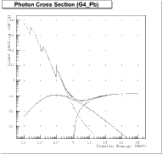



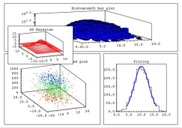










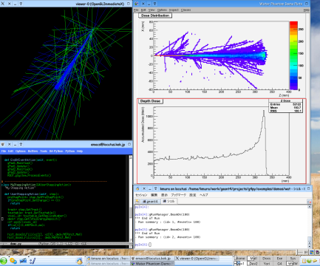


GUI tools
Geant4 Python Interface
interactivity
flexible application configuration
Analysis tools
Python Interface
scripting environment
Python software bus
plug-in modules
Python binding
Python Front End
geometry
C++ class library
primaries
physics process
analysis
web-ware
Grid-ware
User codes
Service tools
User applications

Slide 28
Exposed Classes
Over 100 classes in different categories are exposed to Python.
Classes for Geant4 managers
  G4RunManager, G4EventManager, …
  automatically instantiated as global variables
    gRunManager, gEventManager, …
Classes of base classes of user actions
  G4UserDetetorConstruction, G4UserPhysicsList,
  G4UserXXXAction
    PrimaryGenerator, Run, Event, Stepping,...
  can be inherited in the Python side
Classes having information to be analyzed
  G4Step, G4Track, G4StepPoint, G4ParticleDefinition, ...
  Only safe methods are exposed.
    Getting internal information are exposed. Some setter methods can easily break simulation results.
Classes for describing user inputs
  G4ParticleGun, G4Box, G4PVPlacement, ...
  G4String, G4ThreeVector, G4RotationMatrix,...as utility classes

Slide 29
An Example of C++ vs. Python
Class MySteppingAction : public
G4UserSteppingAction {
// My Stepping Action
void SteppingAction
(const G4Step* step) {
G4StepPoint* preStepPoint=
step->GetPreStepPoint();
G4Track* track=
step->GetTrack();
G4VTouchable* touchable=
track->GetTouchable();
if (preStepPoint->GetCharge()
== 0) return;
G4ThreeVector pos=
preStepPoint->GetPosition()
G4int id=
touchable->GetReplicaNumber()
G4double dedx=
step->GetTotalEnergyDeposit();
}
};
class MySteppingAction
(G4UserSteppingAction):
“My Stepping Action“
def SteppingAction(self, step):
preStepPoint= step.GetPreStepPoint()
track= step.GetTrack()
touchable= track.GetTouchable()
if(preStepPoint.GetCharge() == 0):
return
pos= preStepPoint.GetPosition()
id= touchable.GetReplicaNumber()
dedx= step.GetTotalEnergyDeposit()
Base classes can be inherited and virtual methods can be implemented in the Python side.
Easy to convert between C++ and Python
C++

Slide 30
Practical Notes for Installation
Included in “environments/g4py/” directory
Boost-C++ library is required for wrapping out C++ classes/functions.
Shared libraries are required because of dynamic binding.
  Any external libraries are also required to be built in shared libraries.
Global libraries are required because Geant4Py does not know which granular libraries are used in your application.

Slide 31
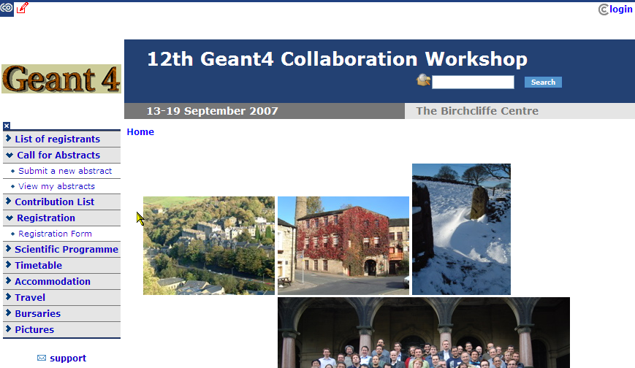
12th Geant4 Collaboration Workshop
http://indico.cern.ch/conferenceDisplay.py?confId=10311
  Manchester, 13-19/Sep/2007
  User presentations
  Collaboration workshop

Slide 32
Hot/Key issues
“Geant4 Physics validation” is always a hot topic.
  At increasing accuracy for established uses
    from HEP experiments, underground experiments, to space and medical applications
  Establishing testing suites for physics lists/processes
What is available in Physics Lists?
  How to find out/communicate physics performance
Improve computing performance
  performance monitor, benchmark
  profiling user program
  code review for gaining performance
  challenge in geometry and field

Slide 33
Physics validation activities
Validation with test beam data from LHC calorimeter (ATLAS/CMS)
Shower shapes
  hadronic shower shape study for LHC calorimeter
  CMS shower shapes
  hadronic validation at FNAL (ITEP, CMS)
CALICE rerport
Underground physics comminity (ILIAS)
Low background experiments
BESIII

Slide 34
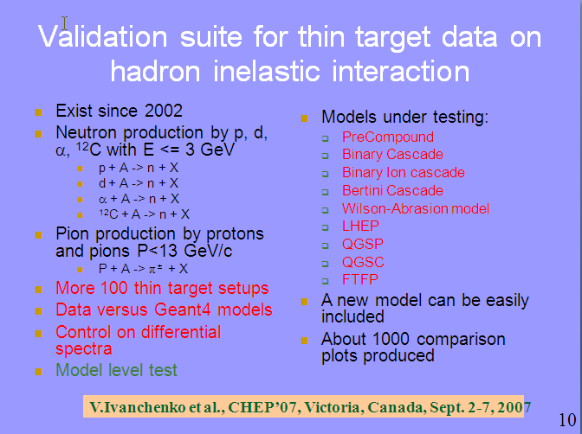
Hadron validation suite

Slide 35
Improvements
Improvements/monitor on CPU performance
Improvement on tracking performance
  parallel navigation and scoring
  tracking in magnetic field
  Geant4e
Improvement on geometry description
Improvements on physics performance
  new physics process/model

Slide 36
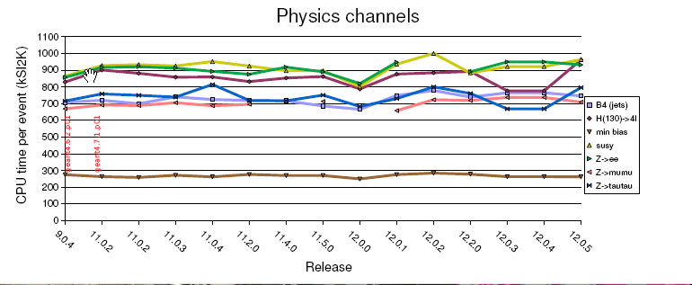
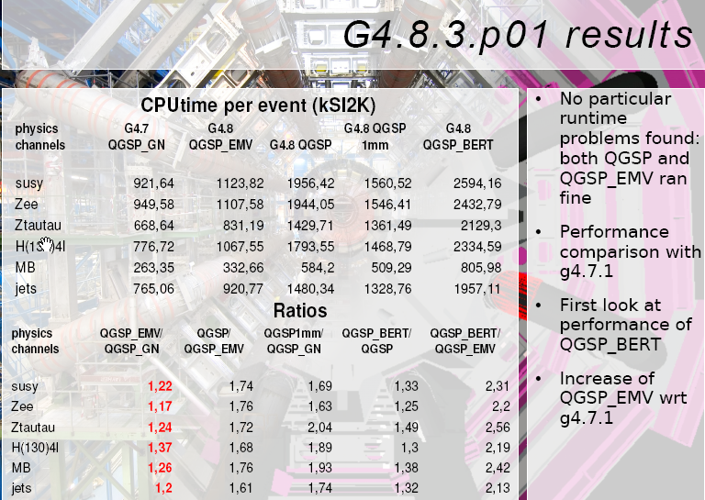
ATLAS experience with G4 performance

Slide 37
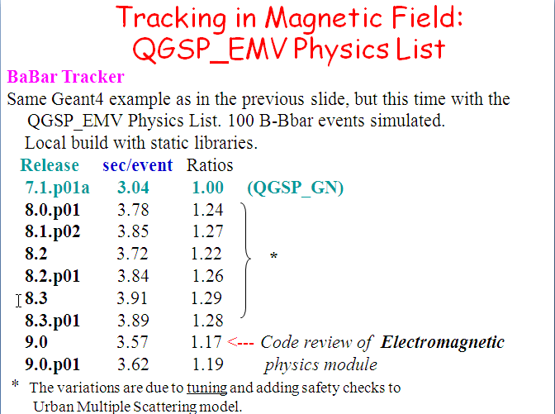
CPU performance monitor, an example

Slide 38
CPU optimization for Geant4 9.0
The review and optimization of interfaces have been performed
  G4VEmModel
  G4VEnergyLossProcess
  G4VEmProcess
  G4VMultipleScattering
  Modifications were provided for all derived classes
Reduction of usage of virtual methods
Reuse STL vectors - reduced calls to new and delete for intermediate vectors
Minor optimization of G4UrbanMscModel code
Summary effect about 10% for EM showers

Slide 39
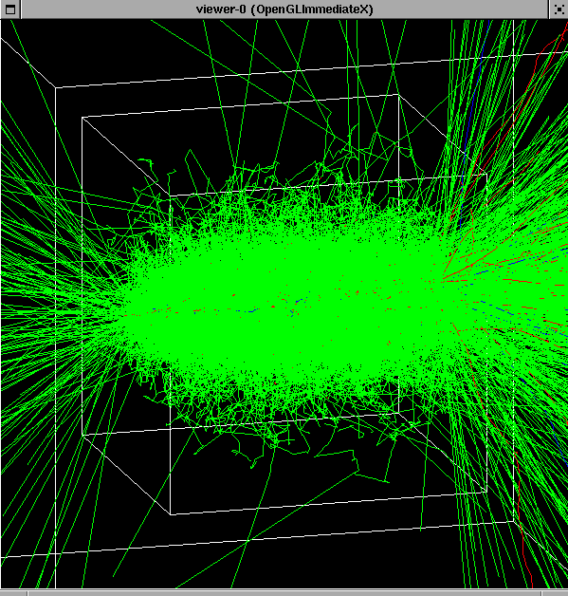
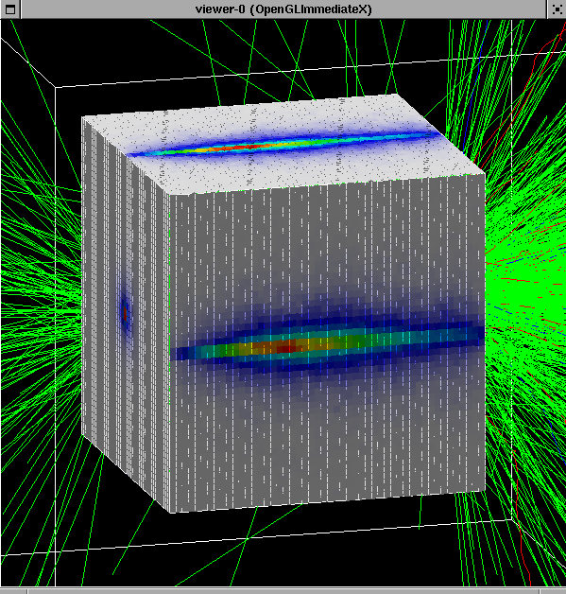
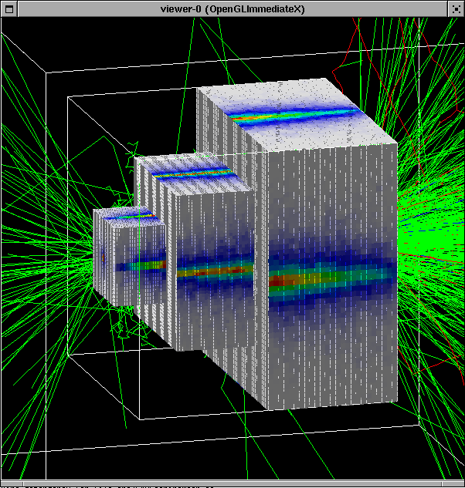
Parallel Geometries & Navigation since 4.8.2, default for biasing in 4.9
Possibility to define geometry trees which are “parallel” and overlapping to the tracking geometry
  Each assigned to a dedicated navigator object
  Navigation transparently happens in sync with the normal tracking (mass) geometry
    Applies transparently to transport in magnetic field
Use cases: fast shower parameterisation, geometrical biasing, particle scoring, readout geometries, etc ...

Slide 40
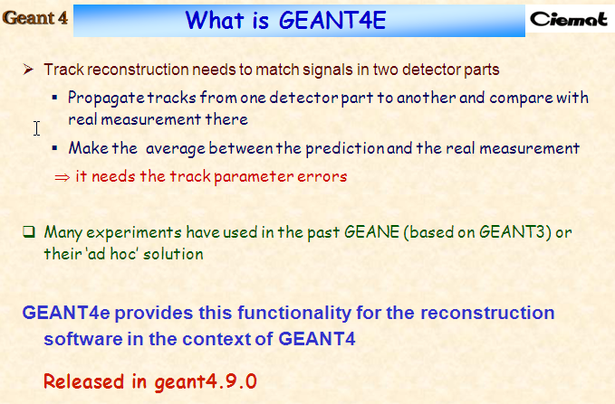
Error propagation module Geant4e

Slide 41
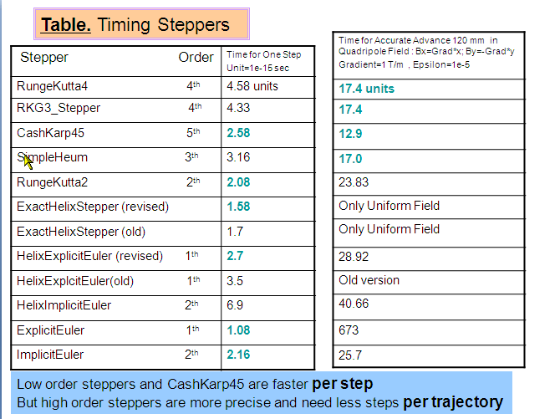
Stepper performance

Slide 42
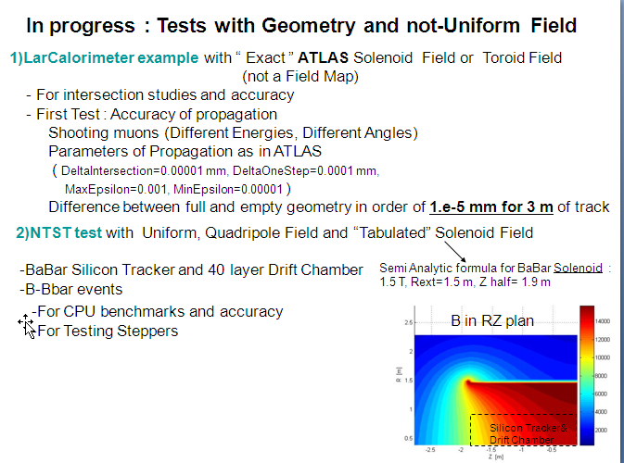
Tests on tracking in field

Slide 43
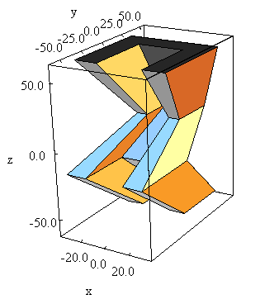
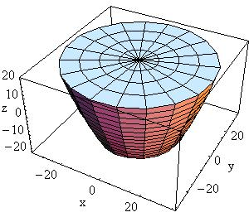
New solids : G4ExtrudedSolid and G4Paraboloid
Since 8.3
Scheduled for 4.9.1
G4Paraboloid by
Lukas Lindroos (Summer Student)
G4ExtrudedSolid by
Ivana Hrivnacova (IPN,Orsay,France )
G4ExtrudedSolid represents the extrusion
Z direction of an arbitrary polygon
For each Z section position with
offset and scale factor is defined.
The solid is implemented as a
specification of G4TessellatedSolid
G4Paraboloid is a full Paraboloid
with possible cut in Z
Equation : z = a*r²+b
On the picture:
G4Paraboloid(Name,dz,R1,R2)
dZ = 20 and
R1 = 20 (at z=-20)
R2 = 35 (at z=20)

Slide 44
Multiple scattering options in G4 9.0
G4SafetyHelper class have been introduced
G4MscStepLimitType
  Minimal - equivalent to the algorithm of Geant4 7.1 and earlier releases (QGSP_EMV Physics Lists)
  UseSafety - the current default, uses geometrical safety (QGSP and QGSP_EMX Physics Lists)
    QGSP_EMX includes sub-cutoff option
  UseDistanceToBoundary - the most advanced, recommended for accurate computations in the cases, where no magnetic field is set
    also option is recommended: skin = 2
Multiple scattering options configurable via UI.

Slide 45
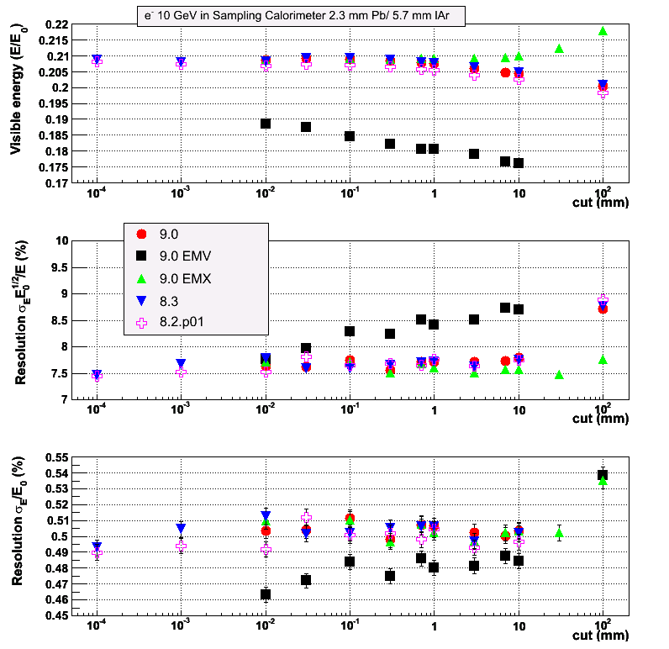
Calorimeter tests
ATLAS barrel type
Practically no difference between 8.3 and 9.0
EMV results are the same as for 7.1p01
Sub-cutoff option (EMX, cut = 7 mm) was optimized
  G4SafetyHelper

Slide 46
Interface change with G4 9.0
EM base classes
  Renamed Physics Lists optional builders
  Renamed EM standard components in examples
  Renamed methods of G4EmProcessOptions
  New UI commands
    /process/msc/
  Updated interface to G4UrbanMscModel
    Parameters can be changed between runs
  Use only G4SafetyHelper
    not G4Navigator anymore
  Removed 52-type processes

Slide 47
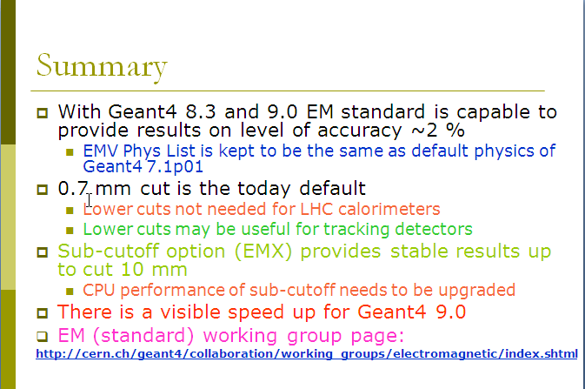
EM Status Summary

Slide 48
Next release, Geant4 9.1
14 Dec/2007 is the scheduled date for Geant4 9.1.

